Slide 1
EPA CALCULATION POLICY 2026- BY CALCULATION
ABRIDGED VERSION

Slide 2
Mathematic Mastery
At the centre of the mastery approach to the teaching of mathematics is the belief that all children have the potential to succeed. They should have access to the same curriculum content and, rather than being extended with new learning, they should deepen their conceptual understanding by tackling challenging and varied problems.
Similarly, with calculation strategies, children must not simply rote learn procedures but demonstrate their understanding of these procedures through the use of concrete materials and pictorial representations. This policy outlines the different calculation strategies that should be taught and used in Year 1 to Year 6 in line with the requirements of the 2014 Primary National Curriculum.

Slide 3
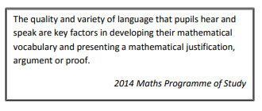
Mathematical Language
The 2014 National Curriculum is explicit in articulating the importance of children using the correct mathematical language as a central part of their learning (reasoning). Indeed, in certain year groups, the non-statutory guidance highlights the requirement for children to extend their language around certain concepts. It is therefore essential that teaching using the strategies outlined in this policy is accompanied by the use of appropriate and precise mathematical vocabulary. New vocabulary should be introduced in a suitable context (for example, with relevant real objects, apparatus, pictures or diagrams) and explained carefully. High expectations of the mathematical language used are essential, with teachers only accepting what is correct.

Slide 4
How to Use the Policy
This mathematics policy is a guide for all staff at EPA schools and has been adapted from work by the White Rose HUB. It is purposely set out as a progression of mathematical skills and year group phases but a flexible approach to teaching and learning is needed according to the cohort and individual needs. It is expected that teachers will use their professional judgement as to when consolidation of existing skills is required or if to move onto the next concept. However, the focus must always remain on breadth and depth rather than accelerating through concepts. Children should not be extended with new learning before they are ready, they should deepen their conceptual understanding by tackling challenging and varied problems.
All teachers use the scheme of work from the White Rose Maths Hub and are required to base their planning around their year groups modules and not to move onto a higher year groups scheme of work. Teachers can use any teaching resources that they wish to use and the policy does not recommend one set of resources over another, rather that, a variety of resources are used. For each of the four rules of number, different strategies are laid out, together with examples of what concrete materials can be used and how, along with suggested pictorial representations. The principle of the concrete-pictorial-abstract (CPA) approach [Make it, Draw it, Write it] is for children to have a true understanding of a mathematical concept, they need to master all three phases within a year group’s scheme of work.

Slide 5
Concrete, Pictorial, Abstract Key

Slide 6
Concrete, Pictorial, Abstract Key
The policy has been adapted from the White Rose Hub’s latest policy (2021) which splits each operation into concrete, pictorial and abstract teaching methodology.
This key will aid teachers in deciding which method to use first to build on successive skills. Generally concrete methods are taught first to build confidence in methodology, then pictorial methods second and finally abstract. However where teachers start will depend on the confidence and ability of the class to grasp abstract concepts.

Slide 7
Addition

Slide 8
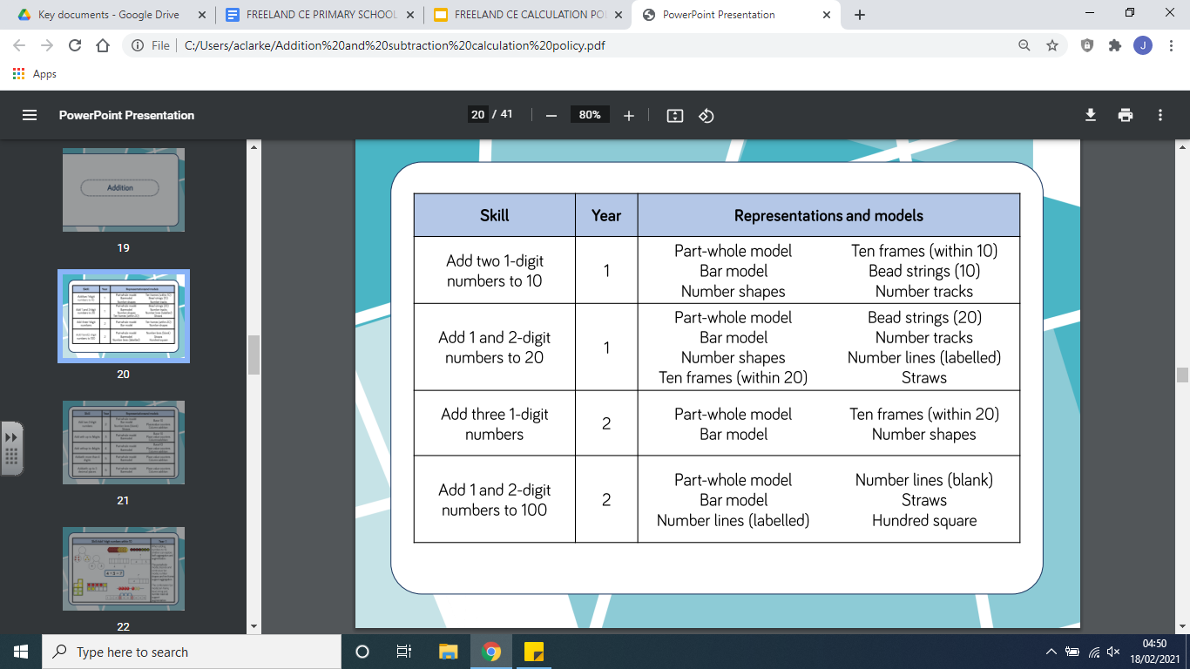

Slide 9
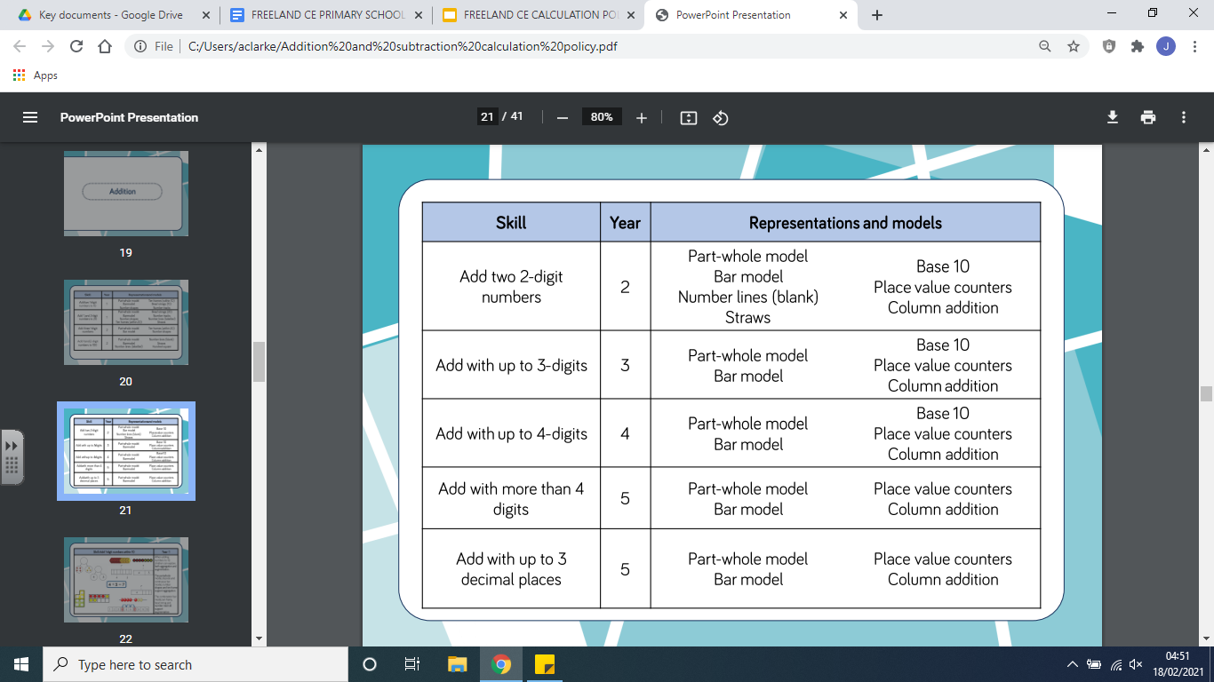

Slide 10
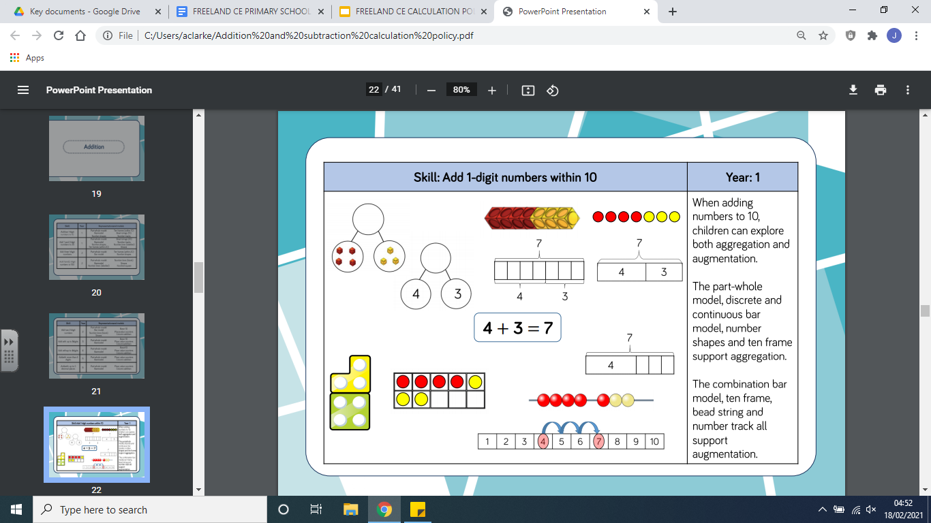
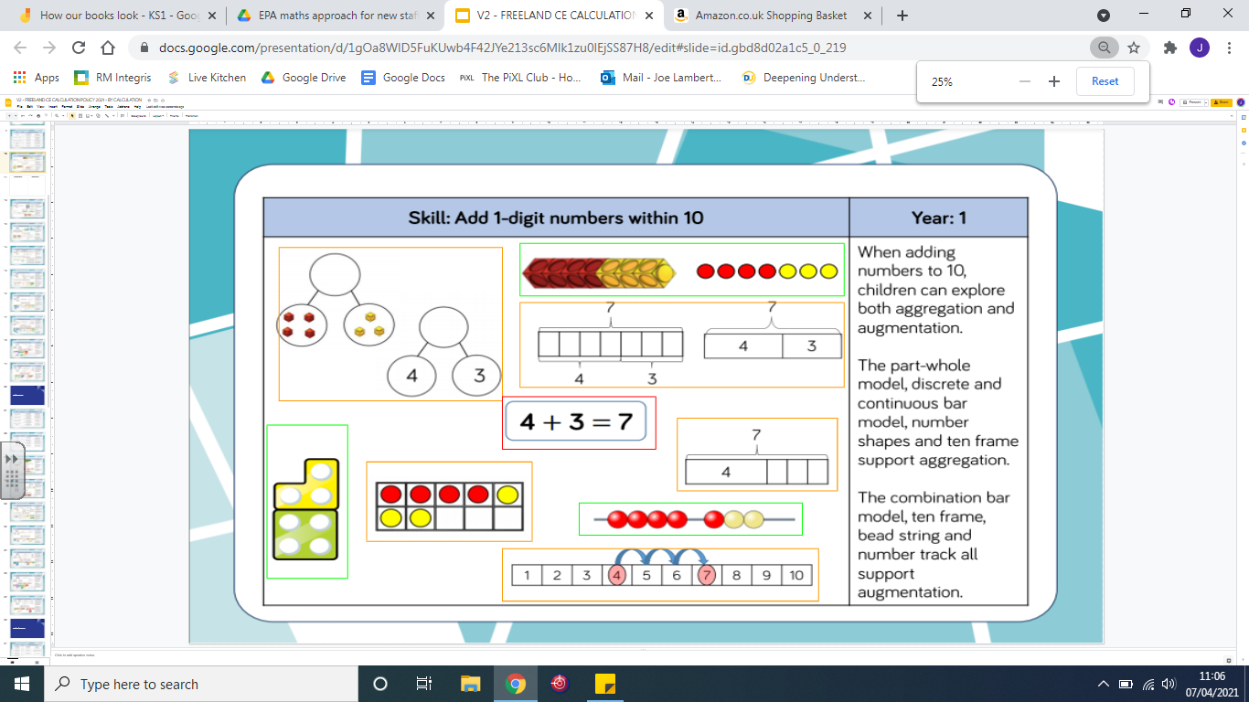
Representation
Methodology
Calculation:
4 + 3 =

Slide 11
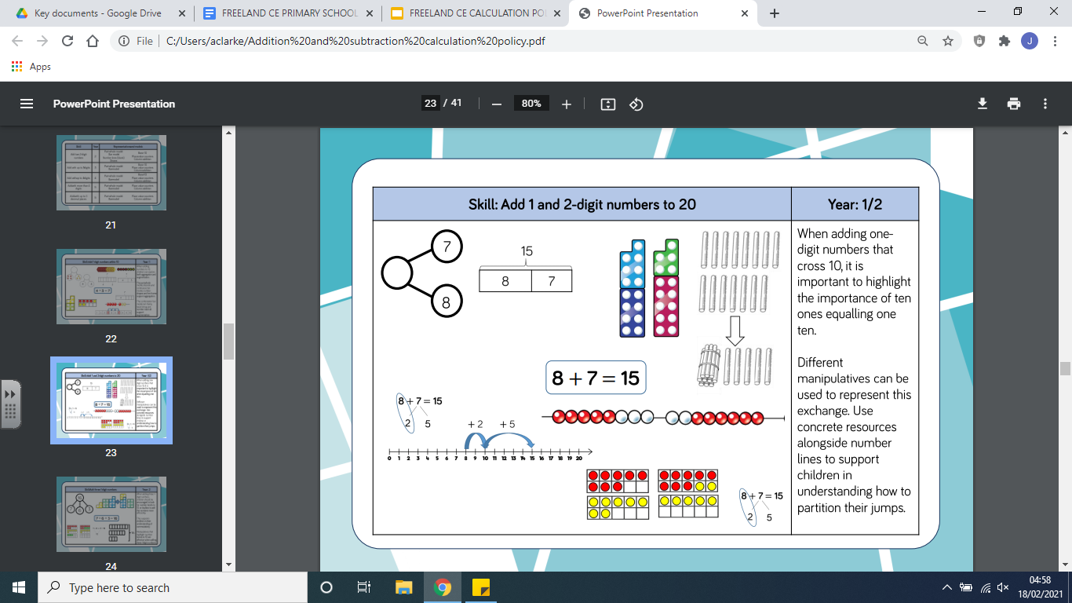
Representation
Methodology
Calculation:
8 + 7 =

Slide 12
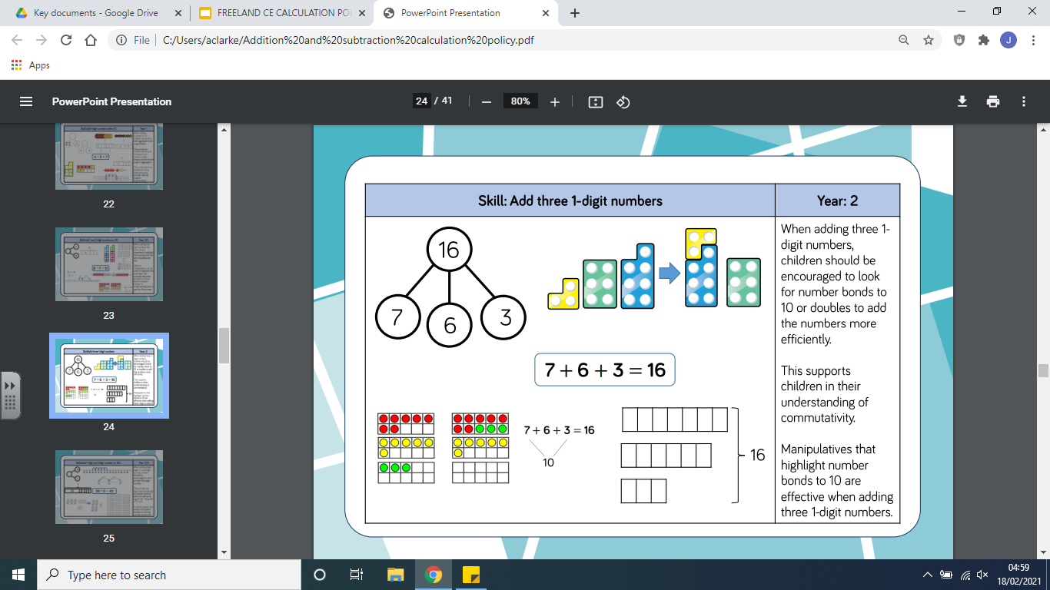
Representation
Methodology
Calculation:
7 + 6 + 3 =

Slide 13
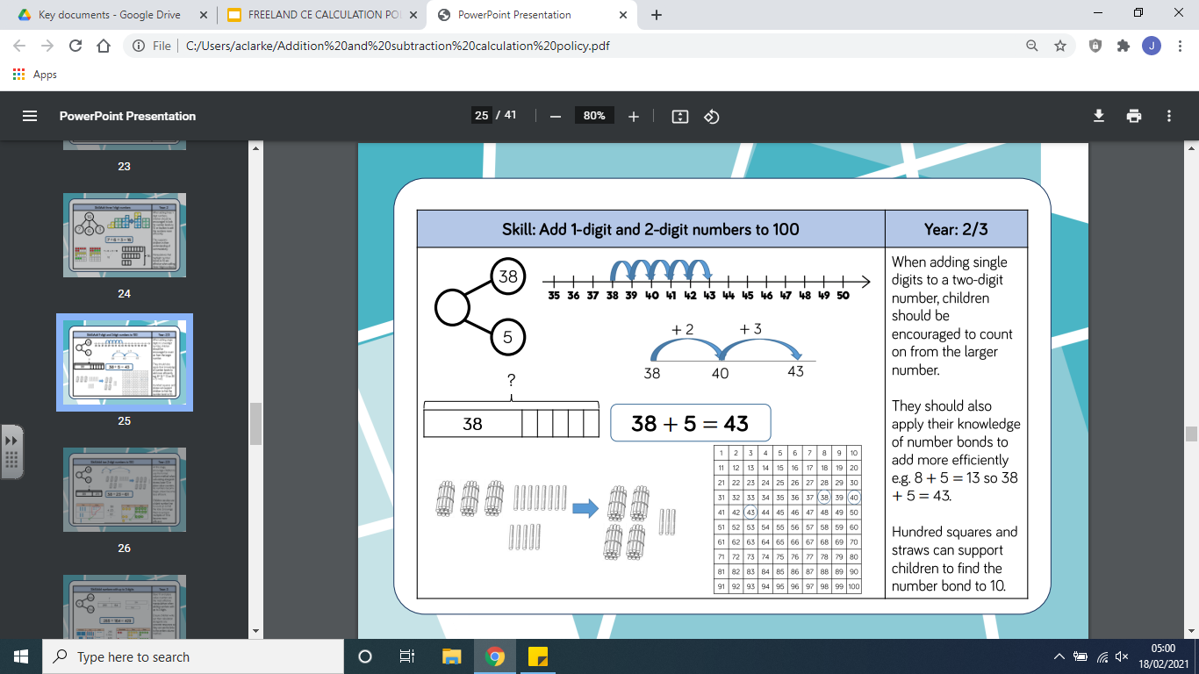
Representation
Methodology
Calculation:
38 + 5 =

Slide 14
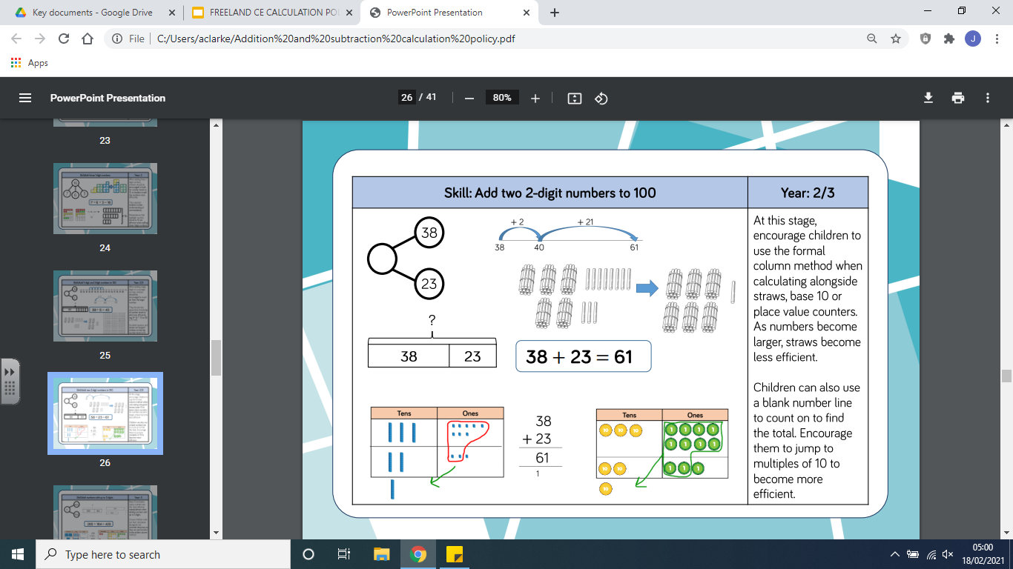
Representation
Methodology
Calculation:
38 + 23 = 61

Slide 15
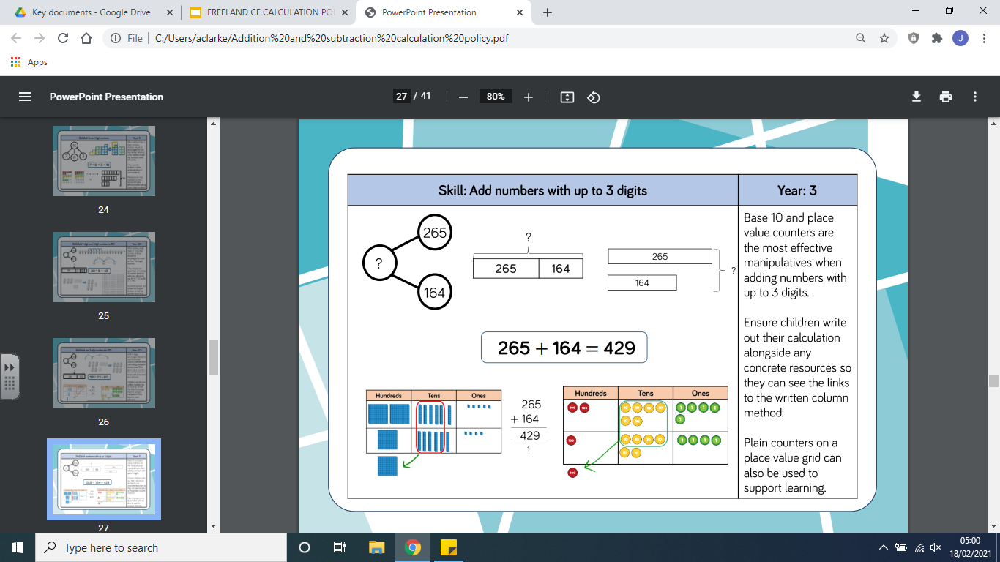
Representation
Methodology
Calculation:
265 + 164 = 429

Slide 16
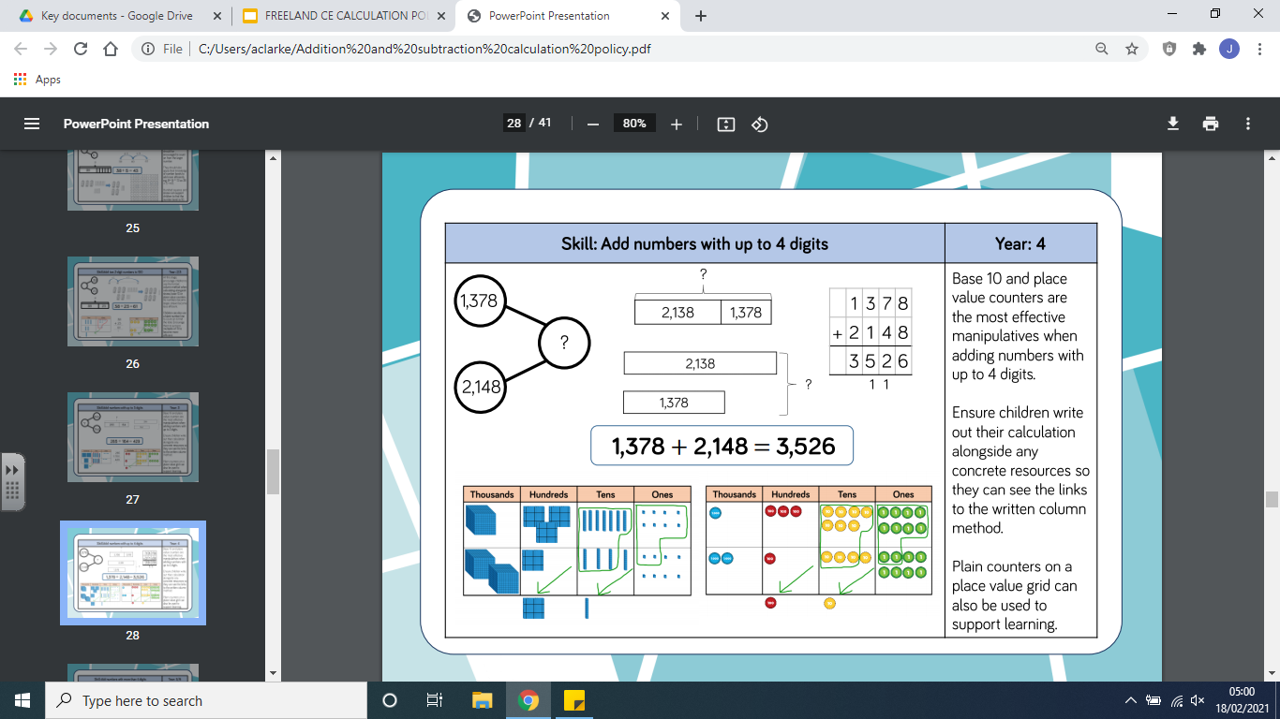
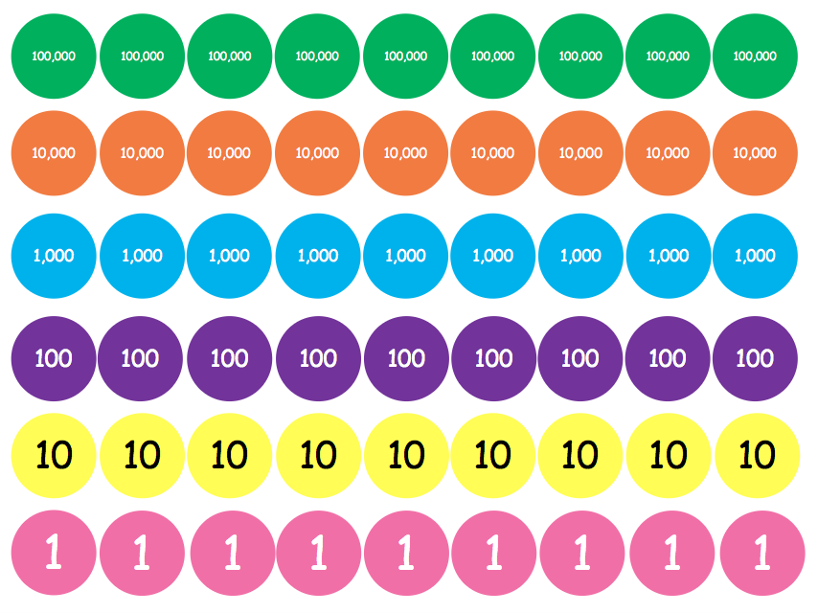
Representation
Methodology
Calculation:
1378 + 2148 = 3526

Slide 17
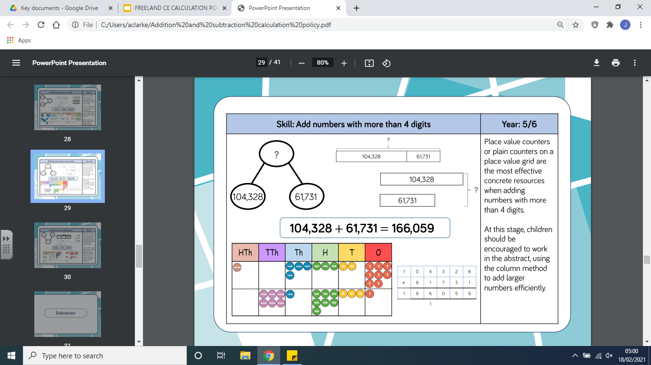
Representation
Methodology
Calculation:
104,328 + 61,731 = 166,059

Slide 18
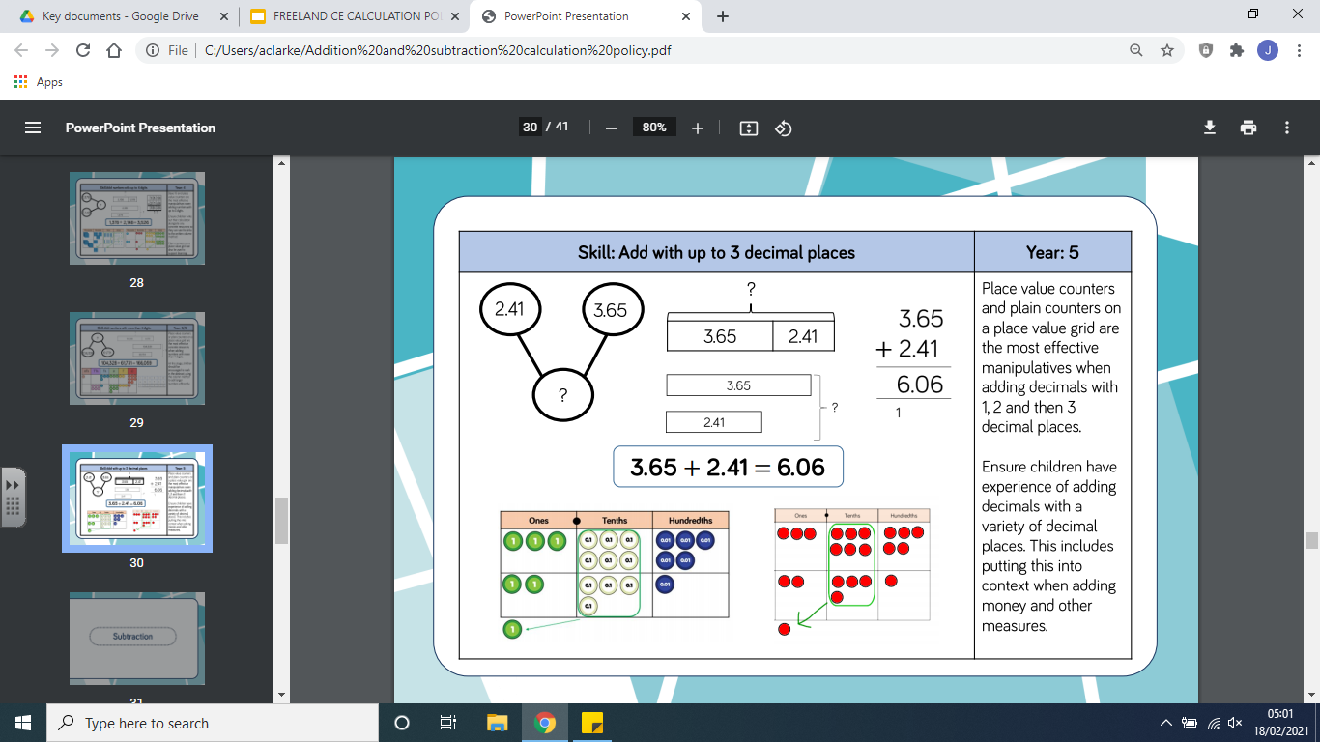
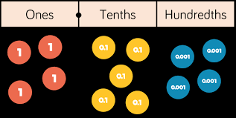
Representation
Methodology
Calculation:
3.65 + 2.41 = 6.06

Slide 19
Subtraction

Slide 20
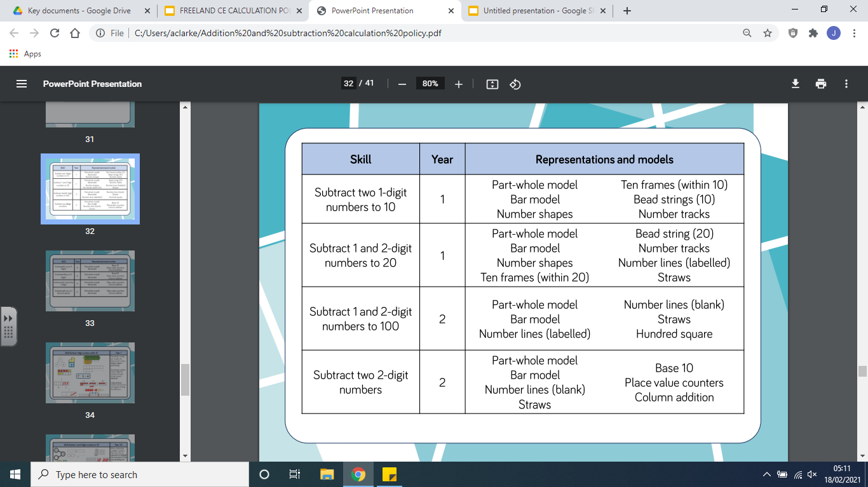

Slide 21
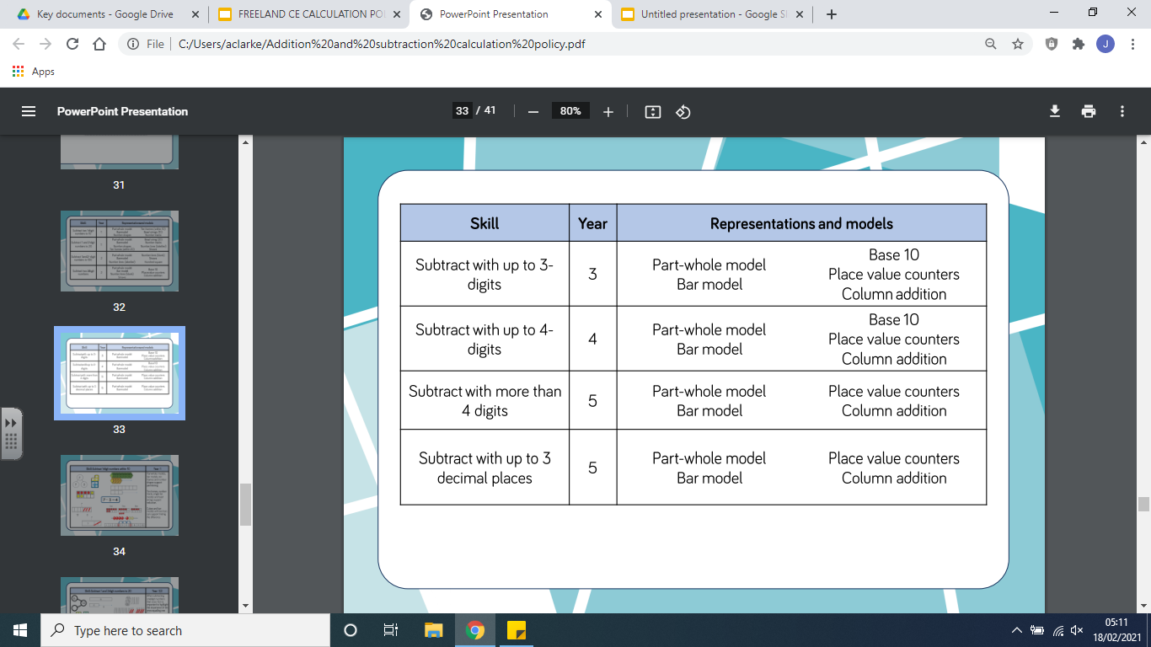

Slide 22
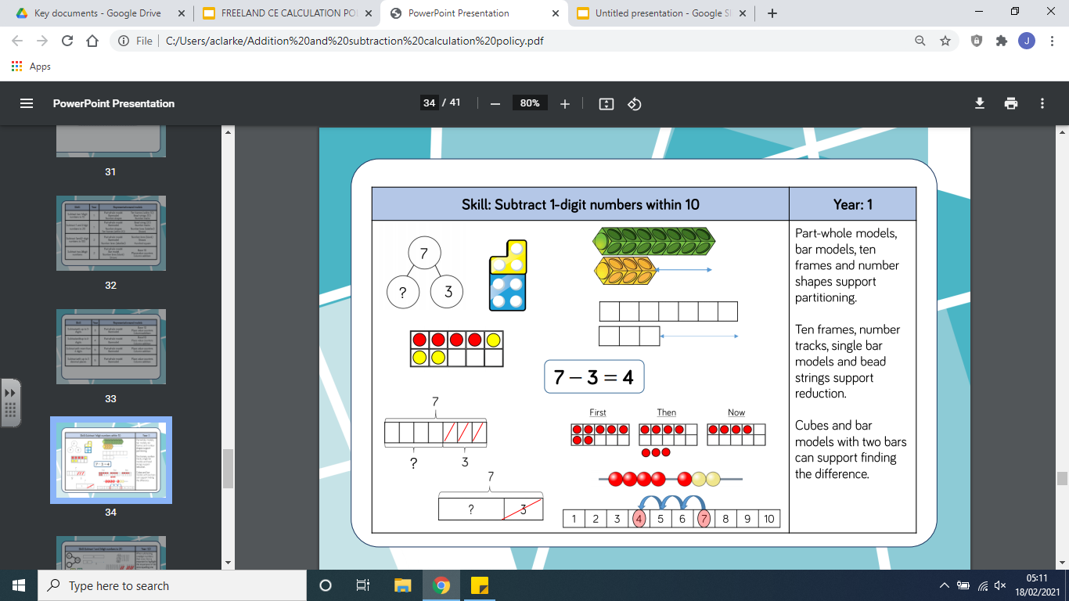
Representation
Methodology
Calculation:
7 - 3 = 4

Slide 23
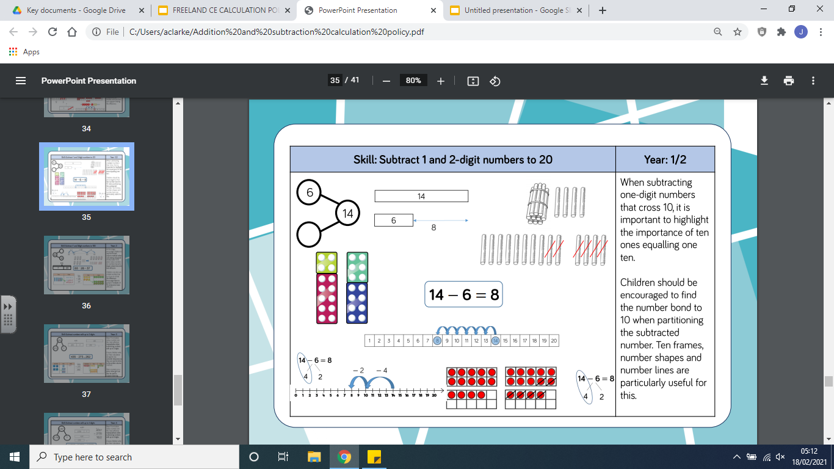
Representation
Methodology
Calculation:
14 - 6 = 8

Slide 24
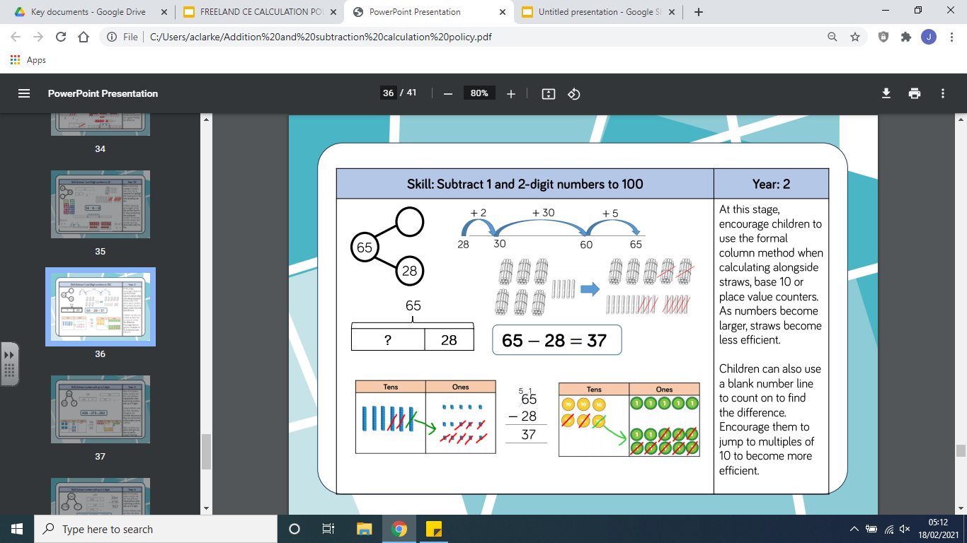
Representation
Methodology
Calculation:
65 - 28 = 37

Slide 25
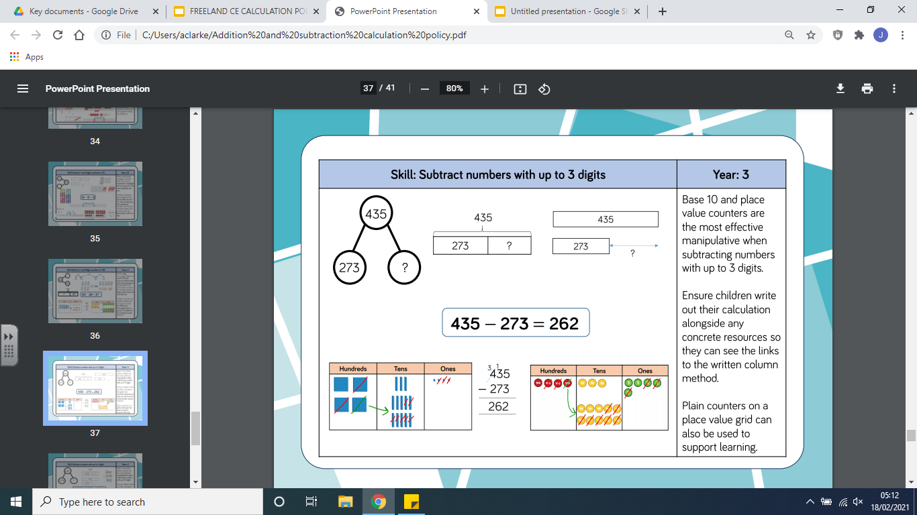
Representation
Methodology
Calculation:
435 - 273 = 262

Slide 26
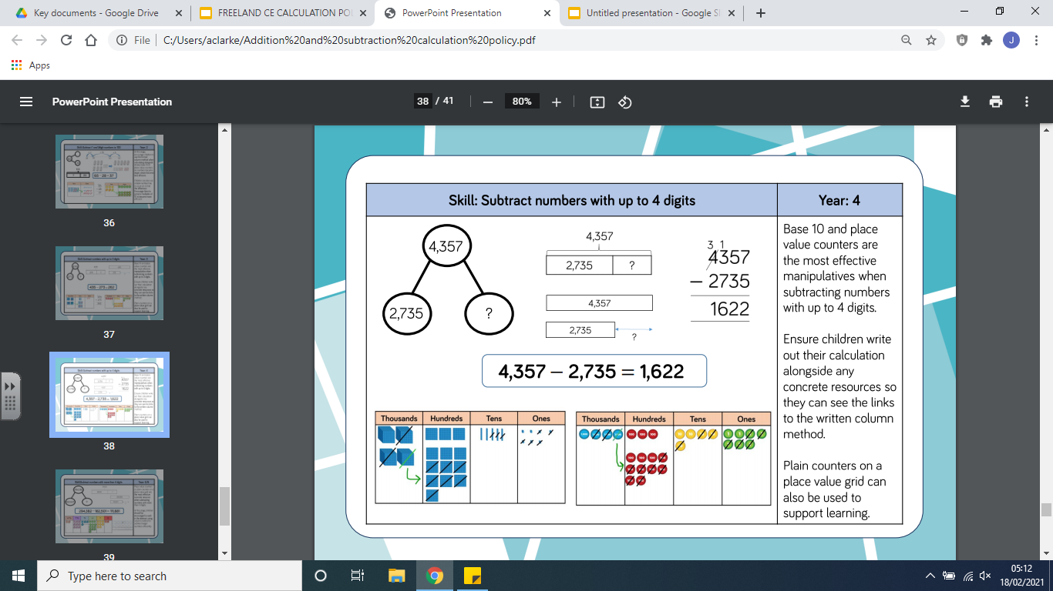
Representation
Methodology
Calculation:
4,357 - 2,735 = 1,622

Slide 27
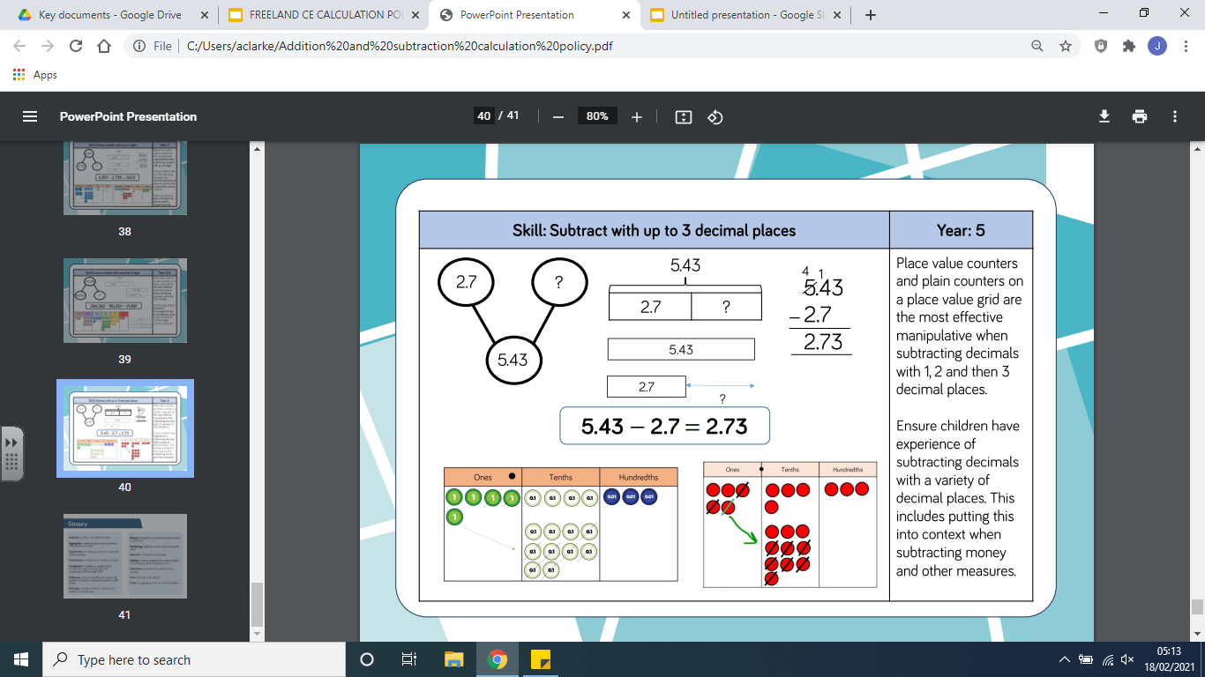
Representation
Methodology
Calculation:
5.43 - 2.7 = 2.73

Slide 28
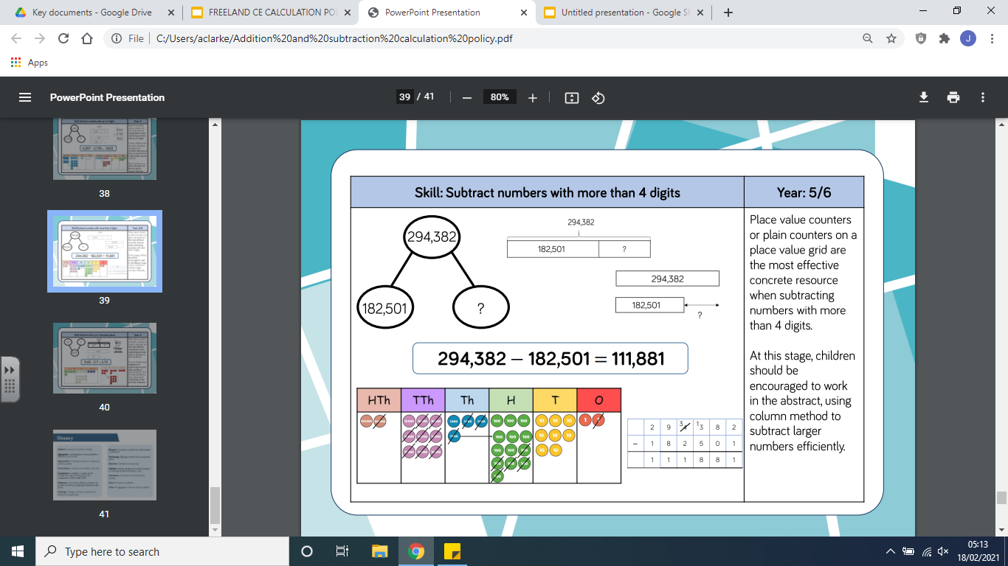
Representation
Methodology
Calculation:
294,382 - 182,501 = 11,881

Slide 29
Multiplication

Slide 30
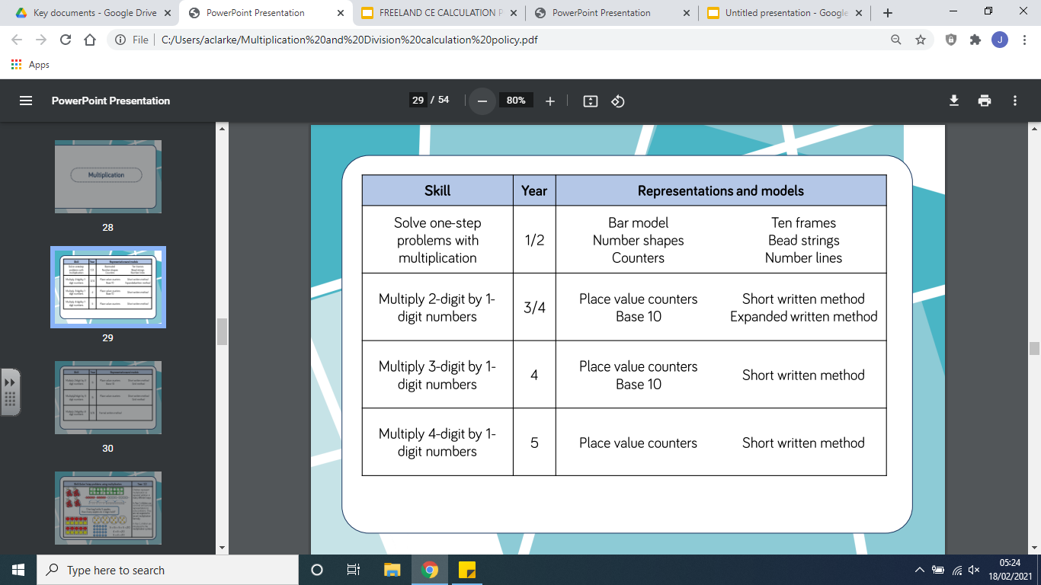

Slide 31
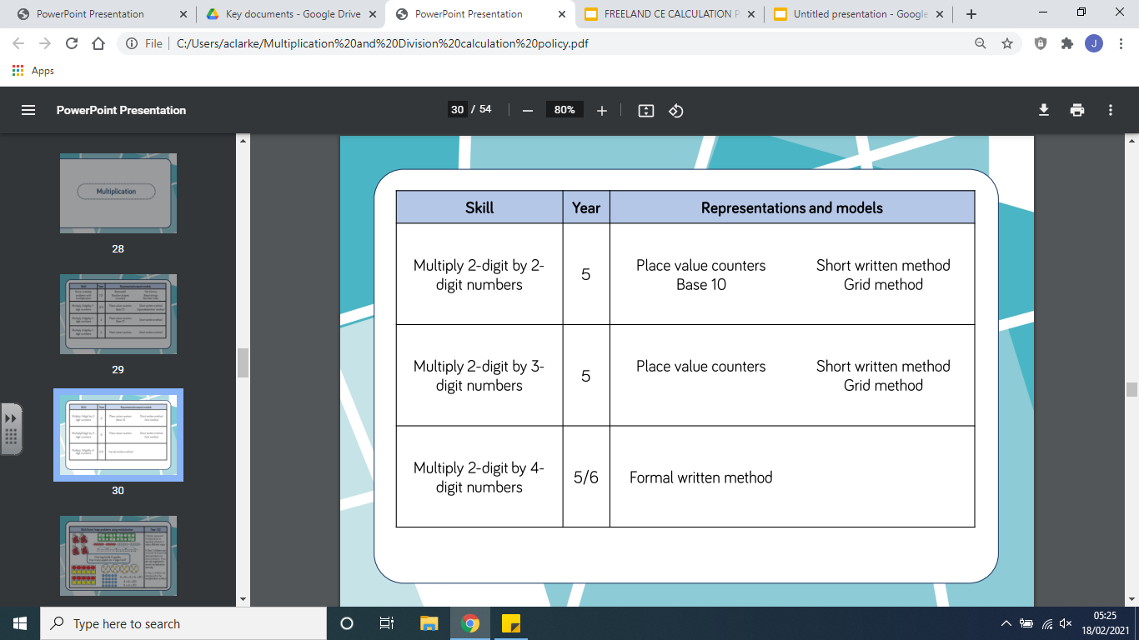

Slide 32
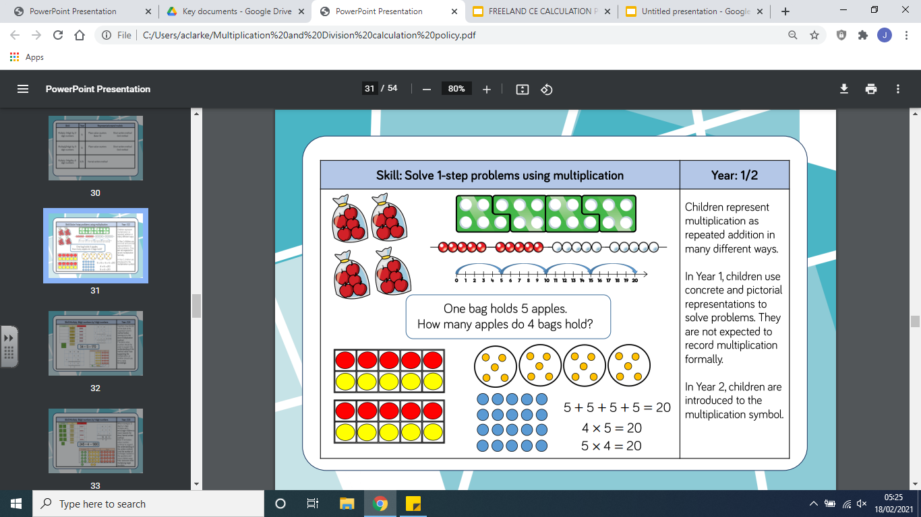
Representation
Methodology
Calculation:
One bag holds 5 apples, how many apples do four bags hold?

Slide 33
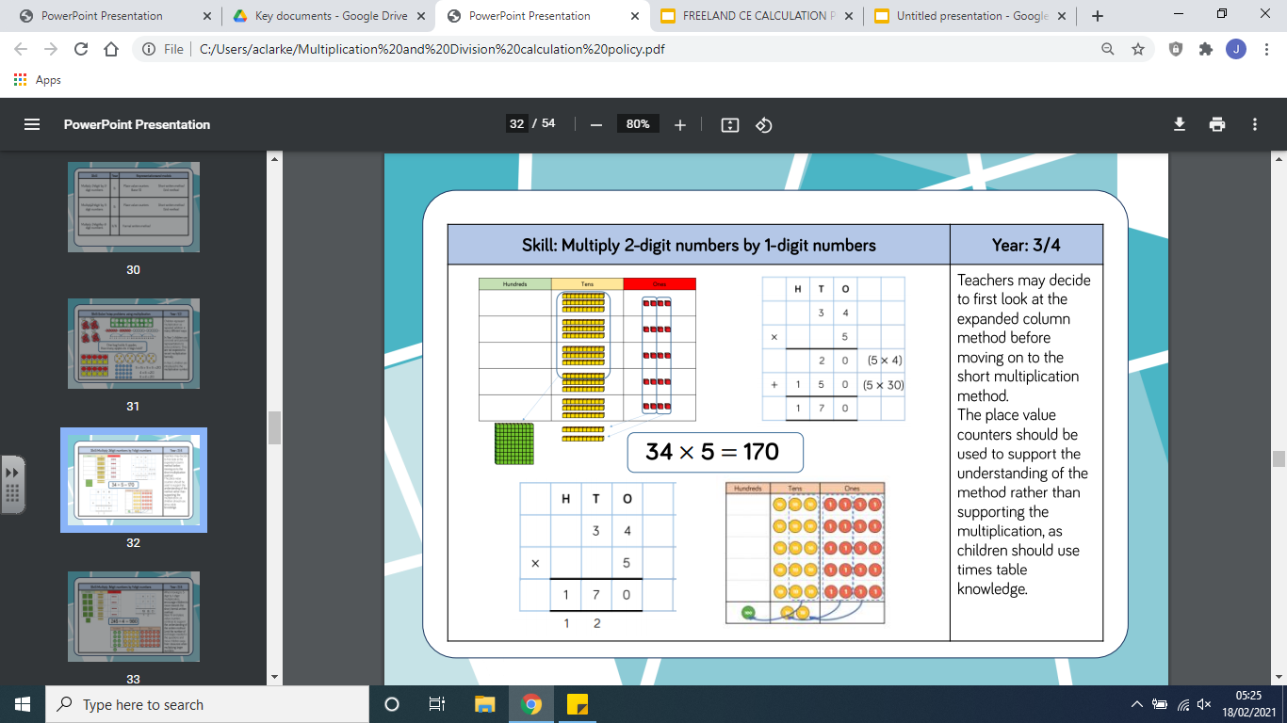
Representation
Methodology
Calculation:
34 x 5 = 170
170
34
34
34
34
34

Slide 34
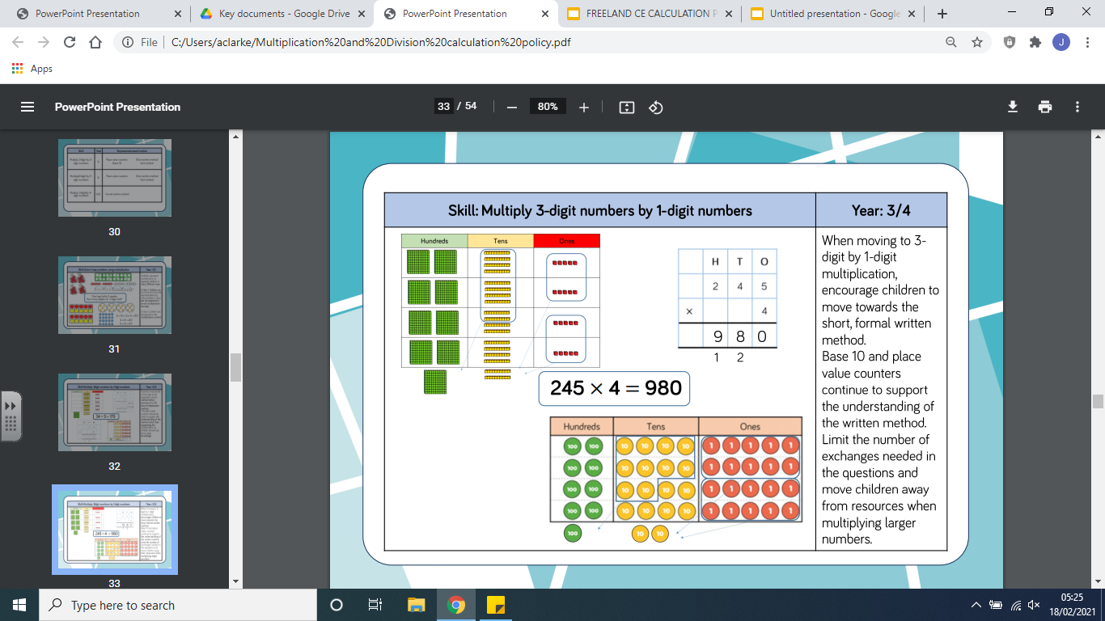
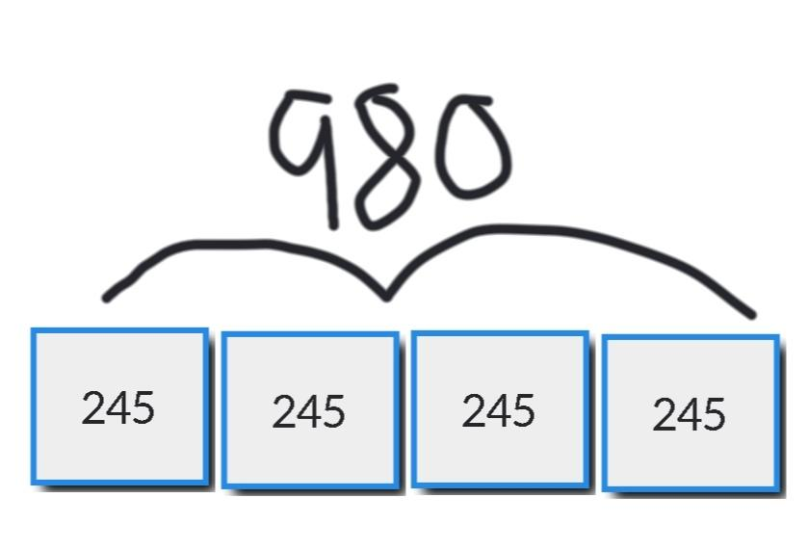
Representation
Methodology
Calculation:
245 x 4 = 980

Slide 35
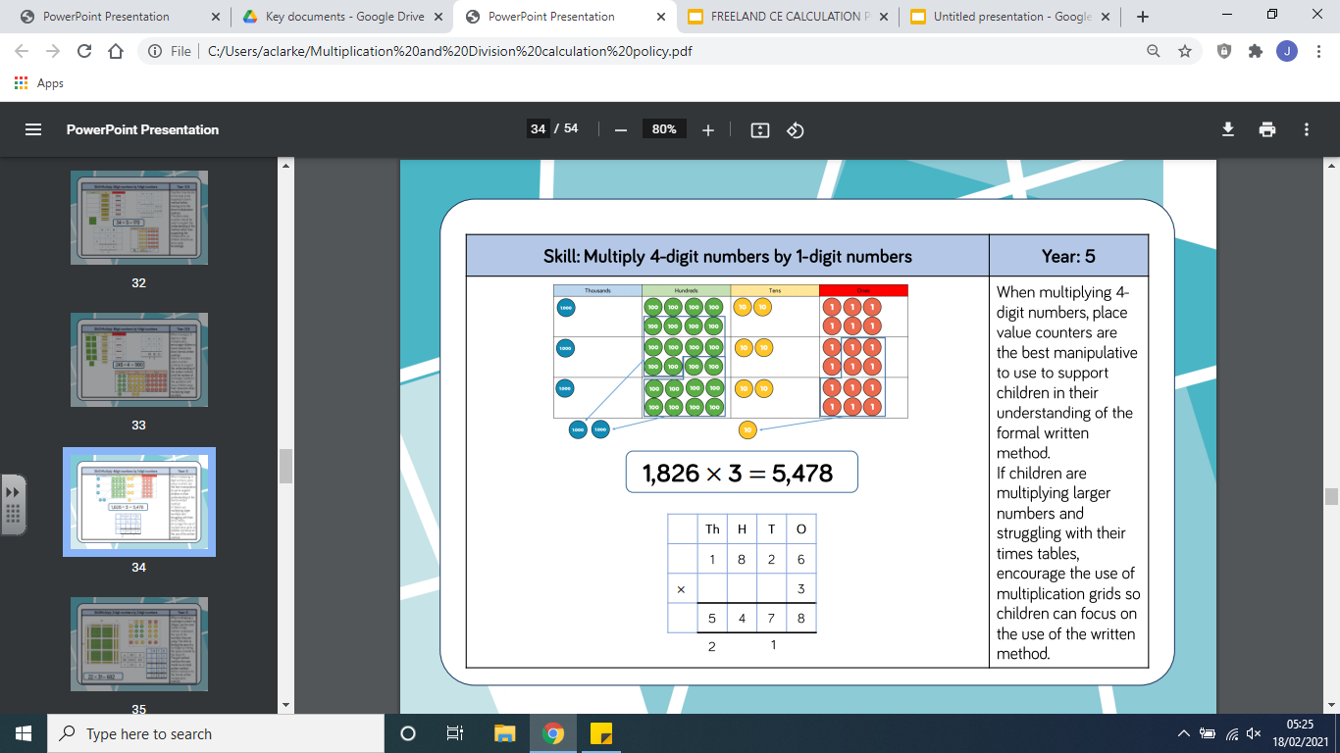
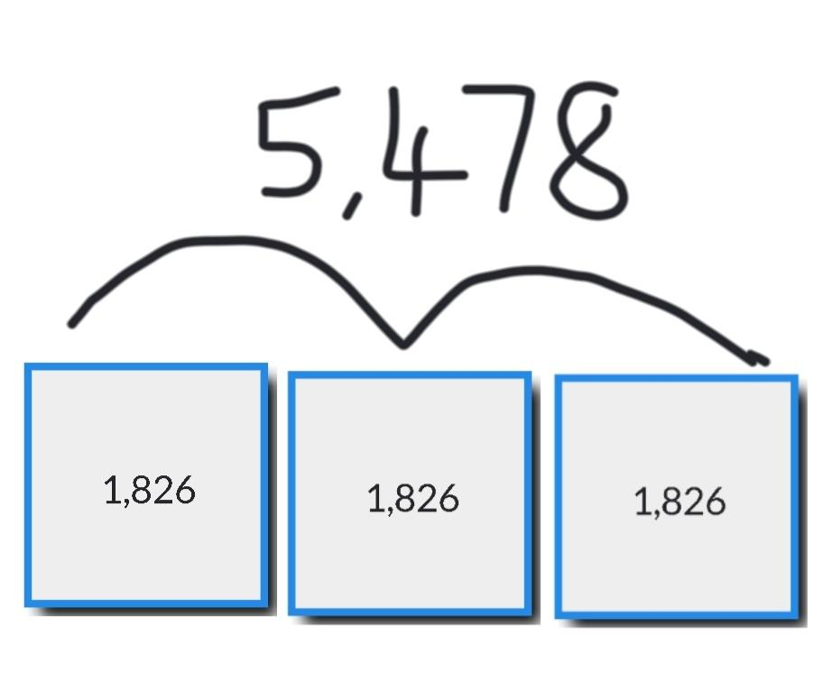
Representation
Methodology
Calculation:
1,826 x 3 = 5,478

Slide 36
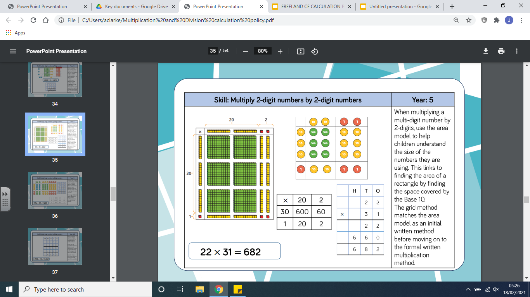
Representation
Methodology
Calculation:
22 x 31 = 682

Slide 37
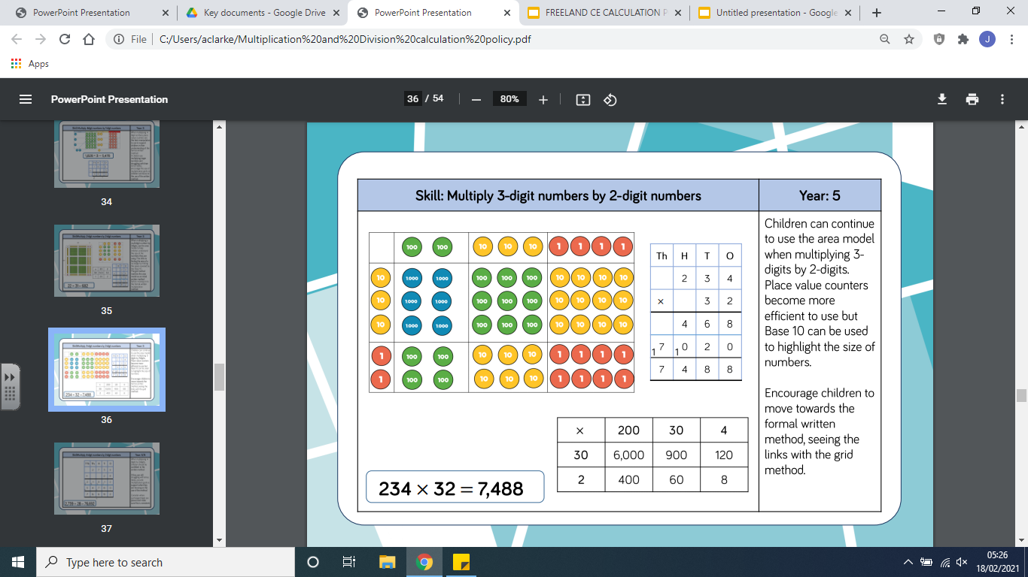
Representation
Methodology
Calculation:
234 x 32 = 7,488

Slide 38
Division

Slide 39
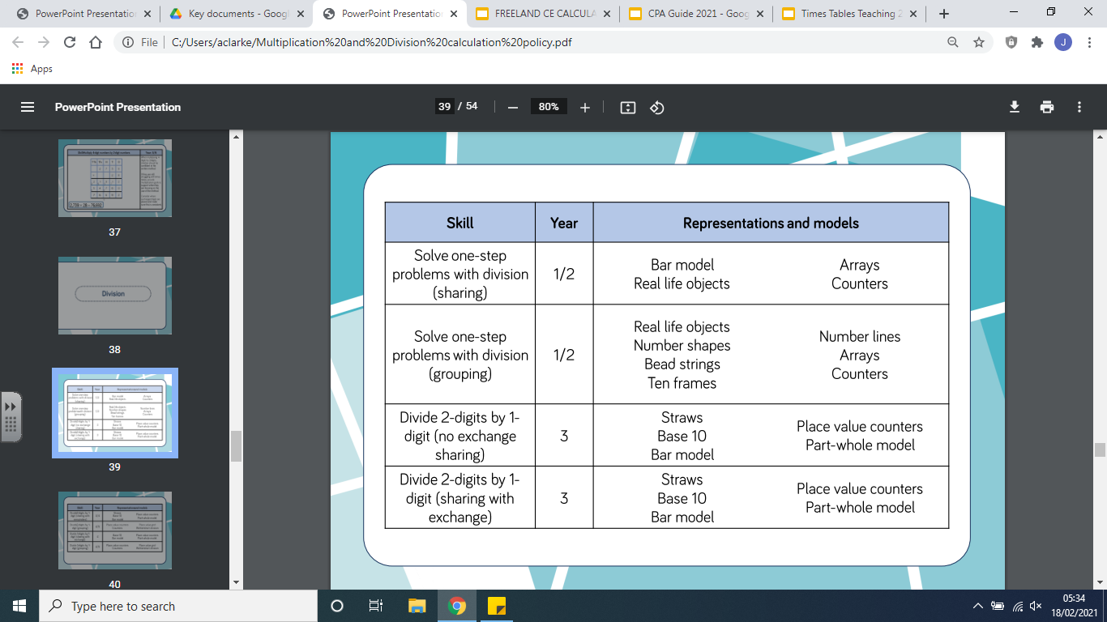

Slide 40
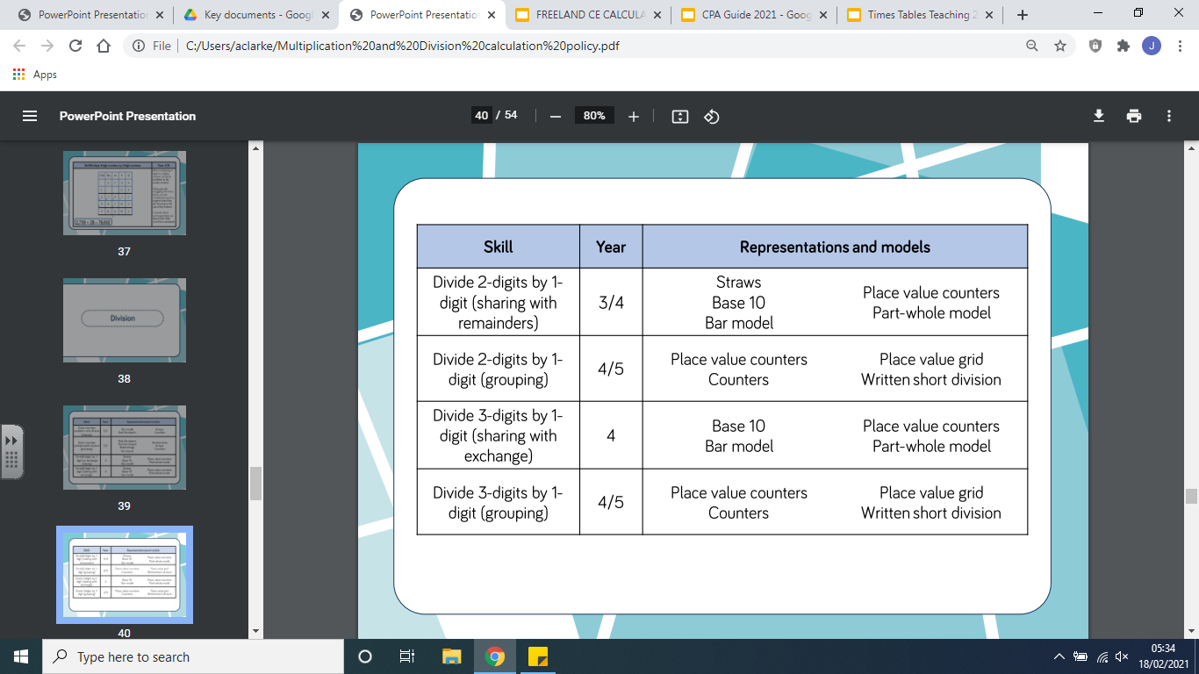

Slide 41
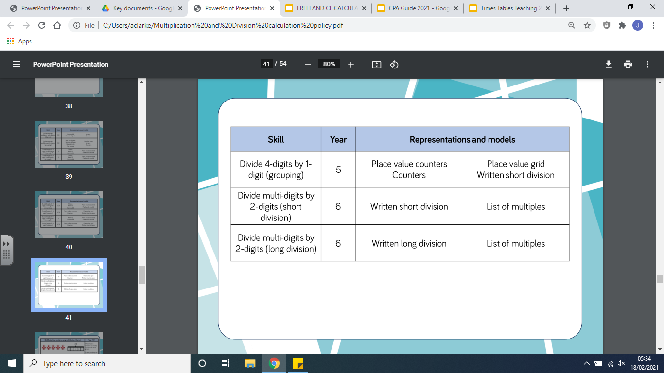

Slide 42
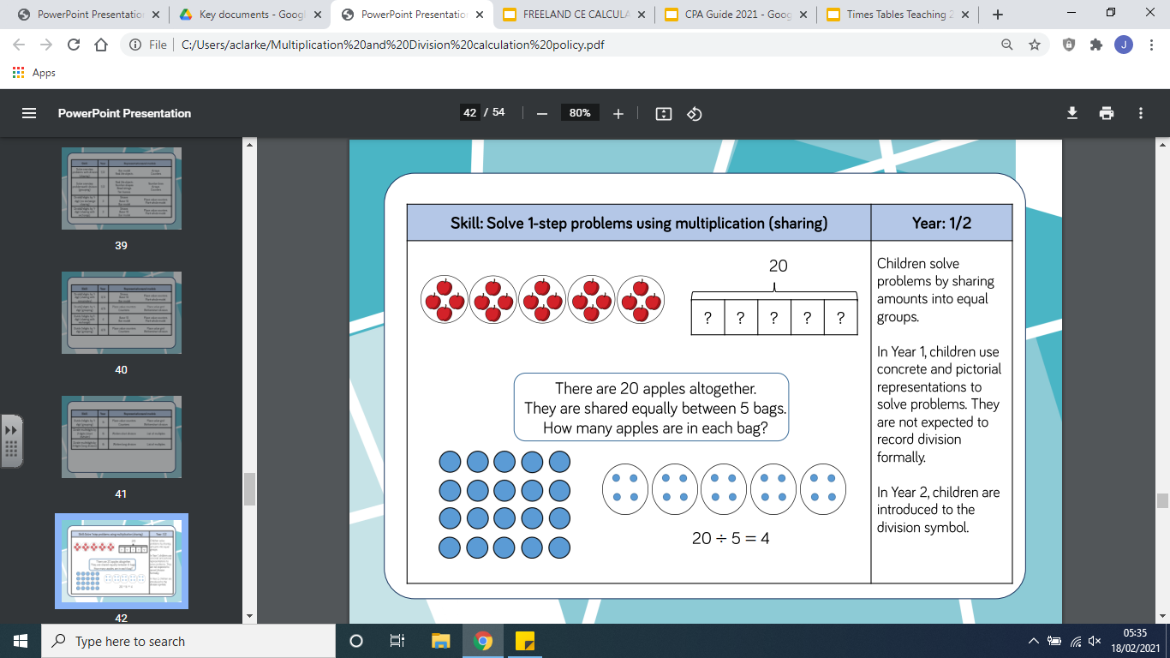
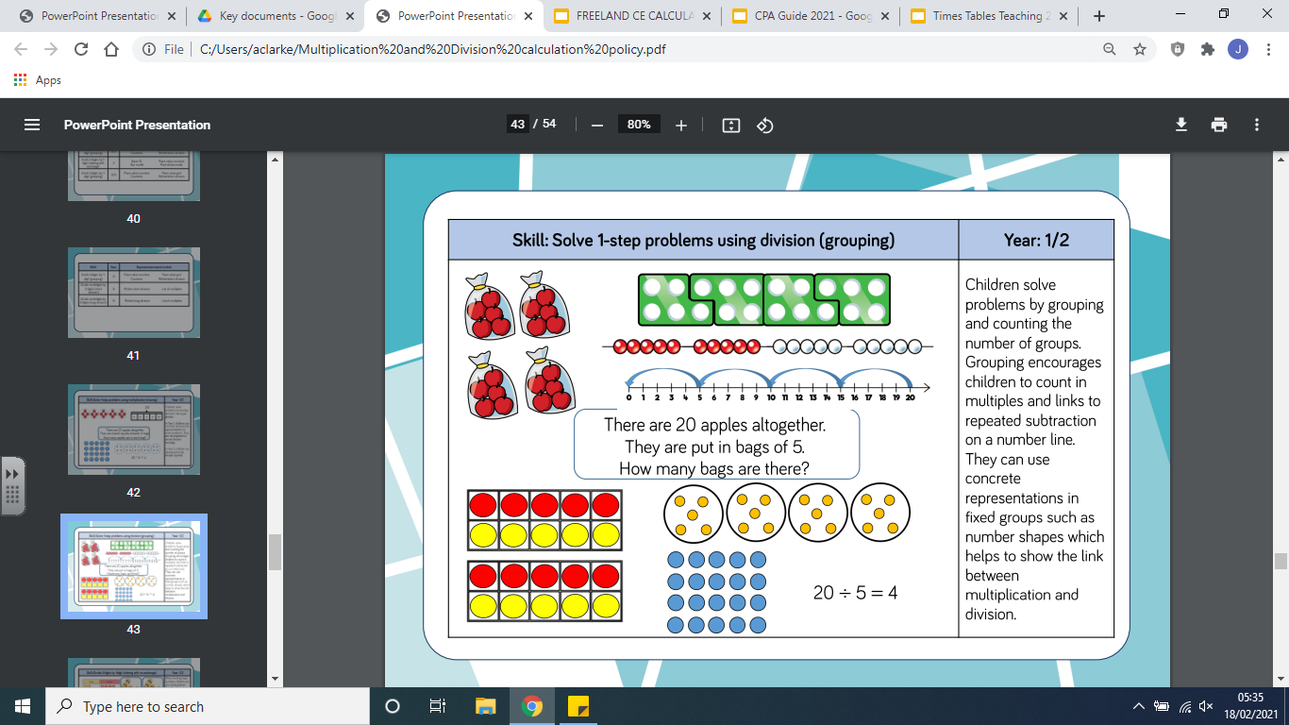
Representation
Methodology
Calculation:
There are 20 apples altogether. They are shared equally between 5 bags. How many apples are in each bag?

Slide 43
Representation
Methodology
Calculation:
There are 20 apples altogether. They are put in bags 5 bags. How many bags are there?

Slide 44
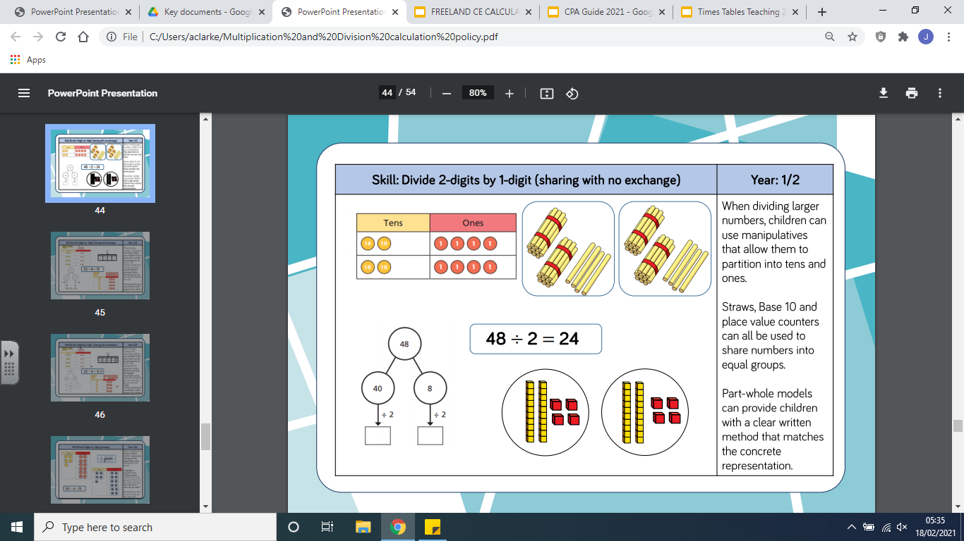
Representation
Methodology
Calculation:
48 divided by 2 = 24
48
?
?

Slide 45
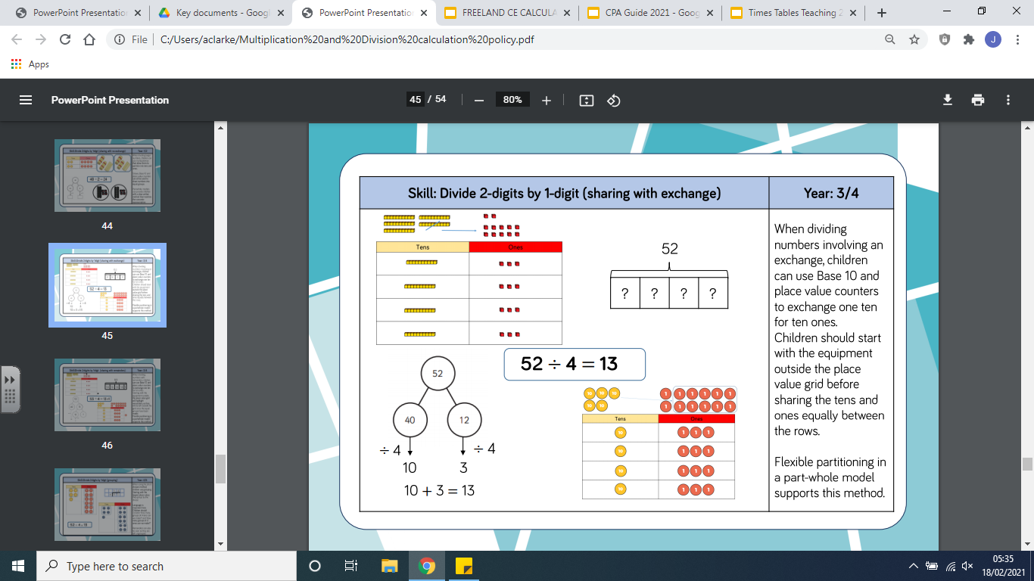
Representation
Methodology
Calculation:
52 divided by 4 = 13

Slide 46
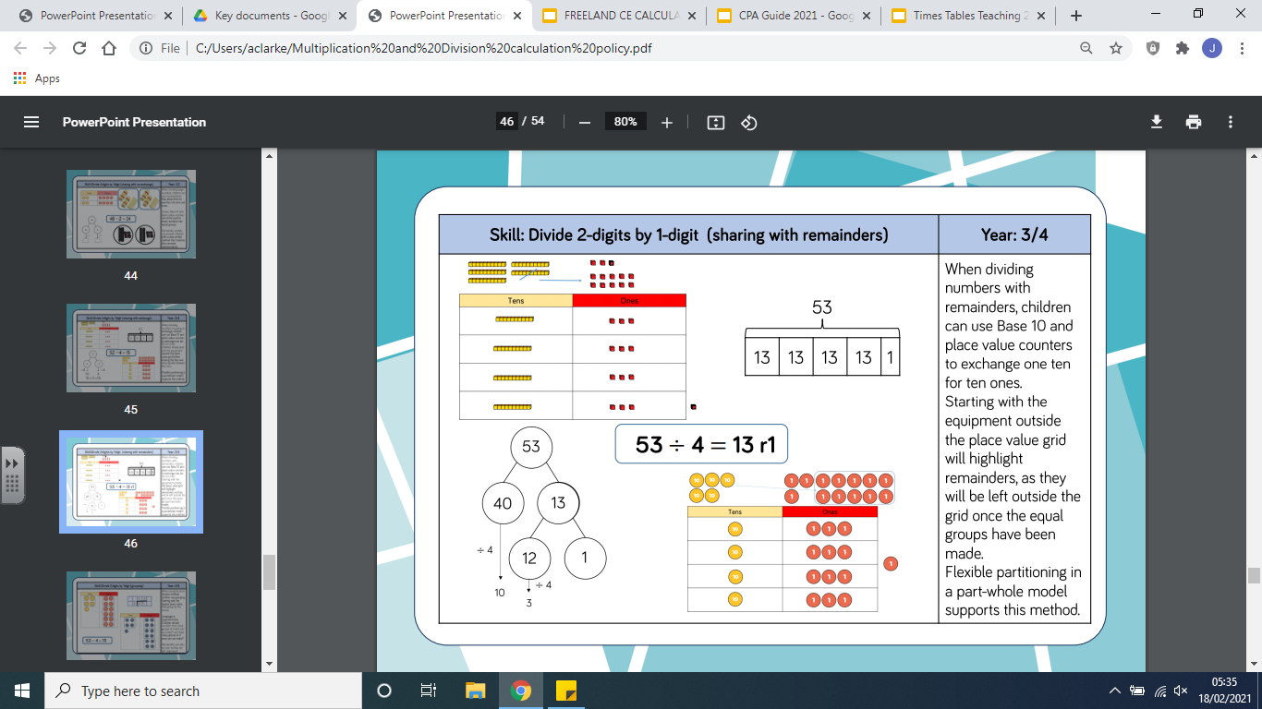
Representation
Methodology
Calculation:
53 divided by 4 = 13r1

Slide 47
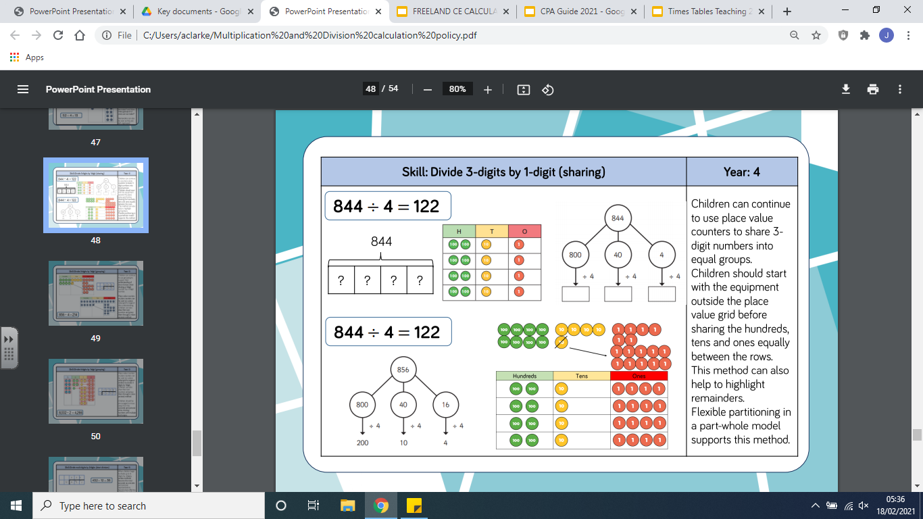
Representation
Methodology
Calculation:
844 divided by 4 = 211
211

Slide 48
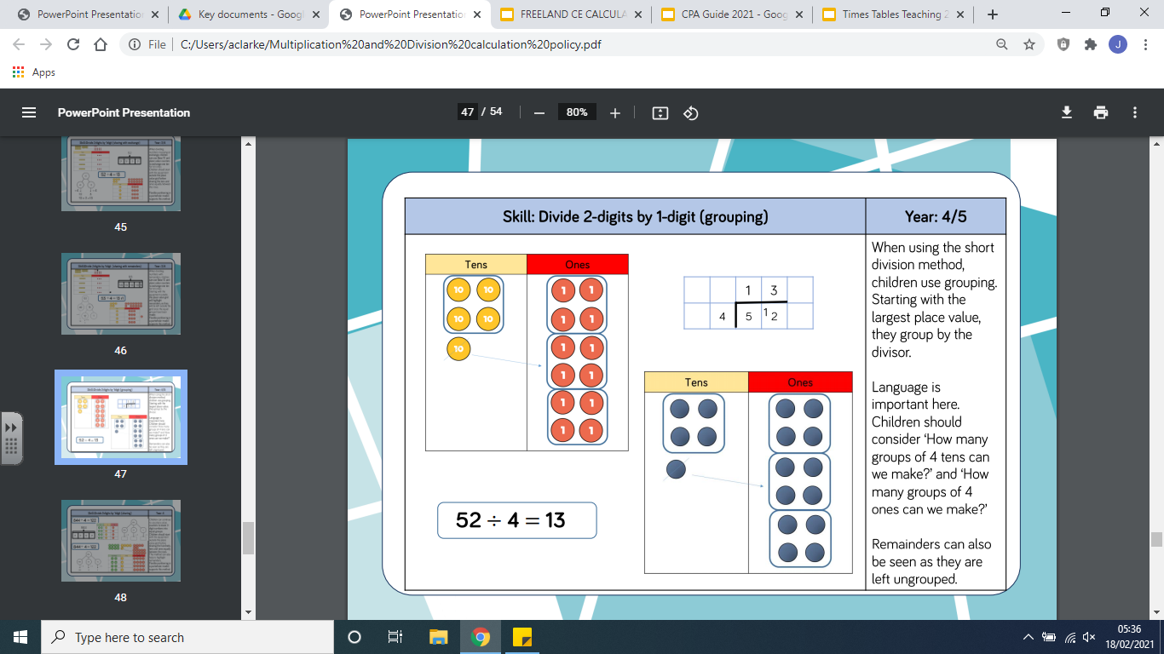
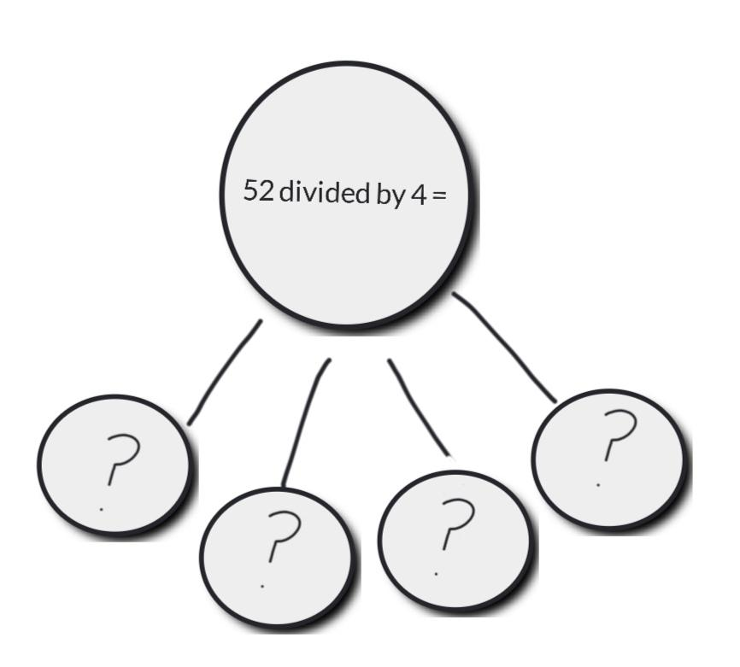
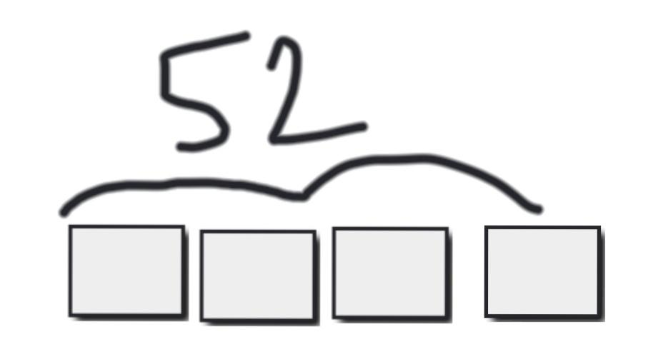
Representation
Methodology
Calculation:
52 divided by 4 = 13

Slide 49
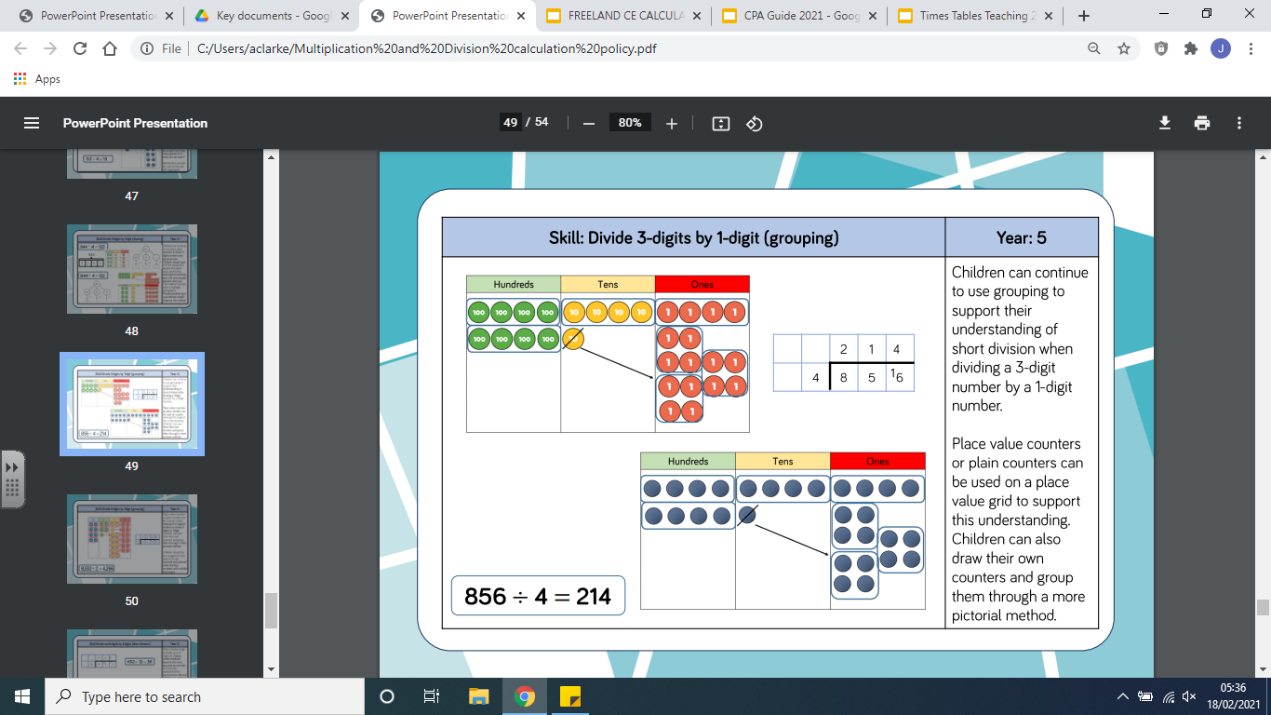
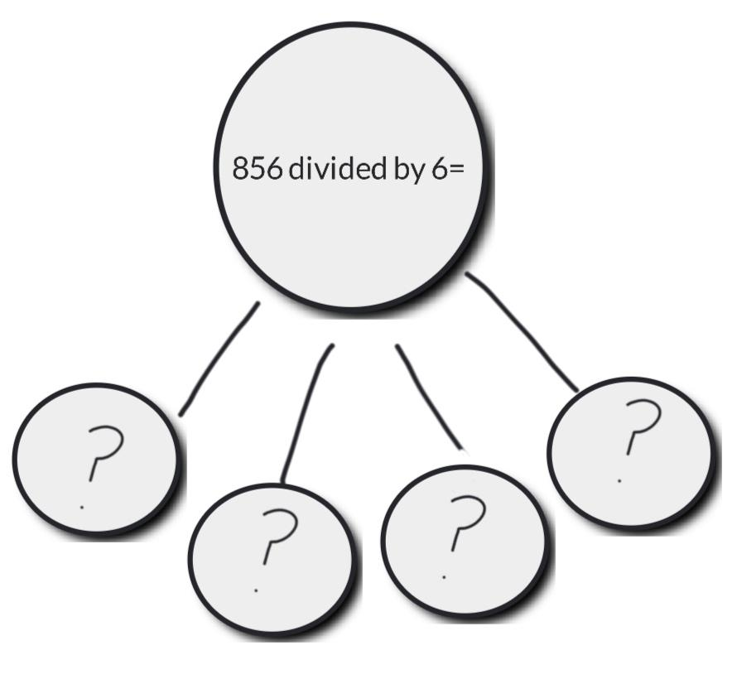
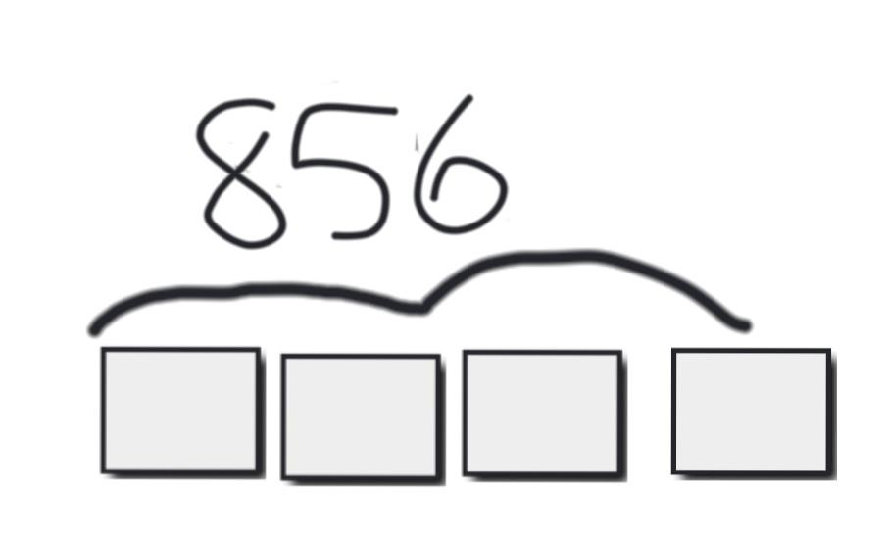
Representation
Methodology
Calculation:
856 divided by 4 =

Slide 50
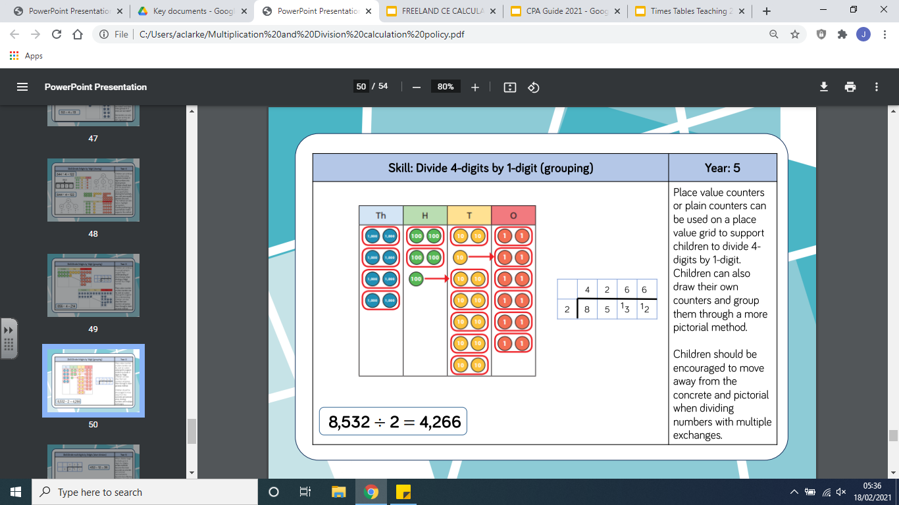


Representation
Methodology
Calculation:
8,352 divided by 2 = 4,266

Slide 51




Representation
Methodology
Calculation:
432 divided by 12 = 36

Slide 52

Representation
Methodology
Calculation:
7,335 divided by 15 = 489

Slide 53


Slide 54


