Slide 1
Teach reading: change lives
Parent workshop: Phonics and early reading
Freeland School

Slide 2

Phonics

Slide 3

Little Wandle Letters and Sounds Revised
We have chosen
‘Little Wandle Letters and Sounds Revised’ as our systematic, synthetic phonics (SSP) programme to teach early reading and spelling

Slide 4
Phonics is:
making connections between the sounds of our spoken words and the letters that are used to write them down.
Notes:
It sounds complicated but it really isn’t!

Slide 5
What do we do in school?
In KS1, phonics is taught daily for 20 minutes using the Little Wandle scheme.
Phase 2 -6 phonics will be taught by the end of Year 1 with clear progression through each stage.
Assessment is carried out every 6 weeks to ensure children keep up with their phonics learning.
‘keep up sessions’ are planned for those children who need extra support with specific sounds/phases.
Handwriting is taught alongside phonics using the Little Wandle writing patter.

Slide 6


Little Wandle Progression
Notes:
We will work our way through the whole Little Wandle Programme until your child can read fluently.

Slide 7

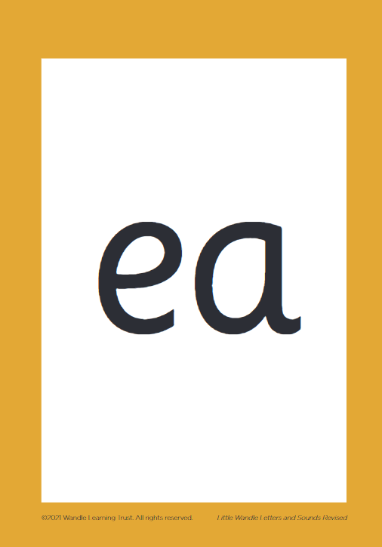
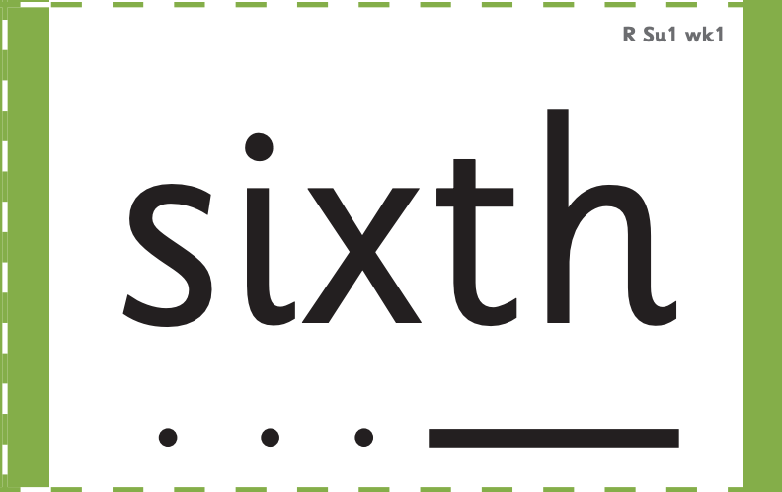



How we make learning stick
Notes:
There are specific resources for the Little Wandle Programme which the children will be very familiar with. Each sound that we teach to begin with has either a mnemonic (like the astronaut that you can see here) or a phrase like boing-boing for ‘oi’. This helps the children recognise and remember the graphemes. Every time we teach a new sound, we also read words during the phonics lesson that contain that new sound so that the children practise what they have learned. We then go on to reading a sentence containing some of those words. We have displays in the classroom and on the tables to support the children throughout the day.

Slide 8
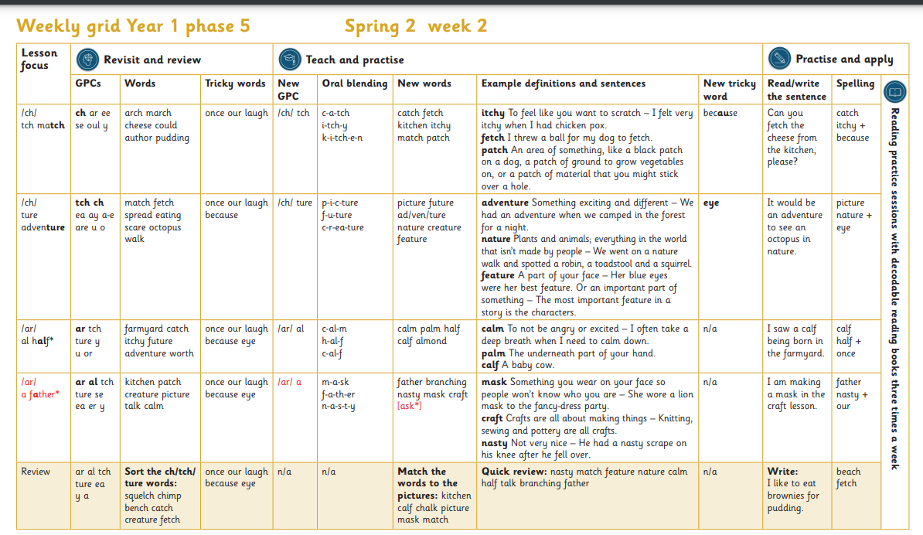

Slide 9
Reading and spelling

Slide 10
Reading and spelling
Notes:
This is an example of what the children learn in Year 1.
Children learn that there are graphemes that can have different sounds and sounds that can be made with different letters.
Use the backs and fronts of Phase 5 cards to show ‘ea’ and ‘ow’.

Slide 11
And all the different ways to write the phoneme sh:
shell
chef
special
caption
mansion
passion

Slide 12
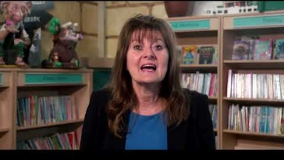
Tricky words
Notes:
Have a look at this video on the website: https://www.littlewandlelettersandsounds.org.uk/resources/for-parents/

Slide 13



Spelling
Say the word (cat)
Segment the sounds (c-a-t)
Count the sounds
Write them down
Notes:
Model the process on a flipchart for the parents to see.

Slide 14
How do we teach reading in books?
Reading practice sessions are:
timetabled three times a week
taught by a trained teacher/teaching assistant
taught in small groups which closely fit the children’s phonic level
Notes:
The children read the same book three times in a week. The first time we work on decoding (sounding out) the words, the second time we work on prosody which is reading with expression – making the book sound more interesting with our story-teller voice or our David Attenborough voice – and the third time we look at comprehension. We read the books three times at school because we want to develop the fluency. The more they see words the more they begin to read them automatically without having to sound them out.

