Slide 1
KS1 SATs
May
2022
Things we will cover:-
What are SATs in Key Stage 1?
What do the SATs tests look like?
How do teachers assess/results?
Age related expectations
What can you do to help?
A year 2 parents’ guide

Slide 2
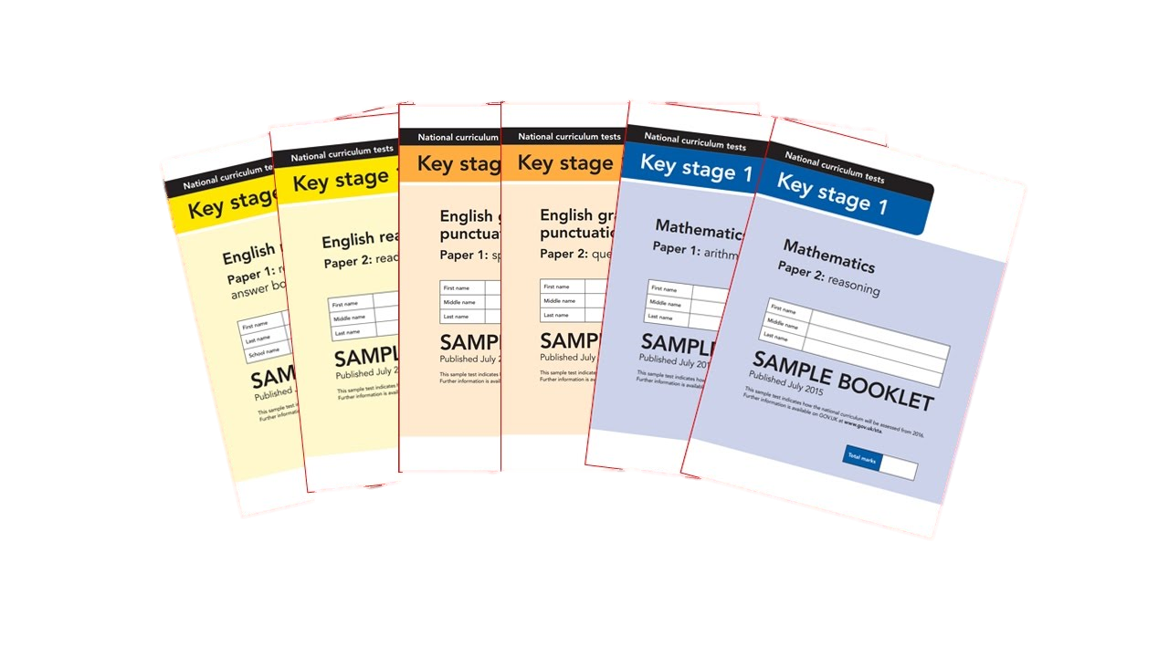
What are Sats?
At the end of Year 2, children in England sit national tests in the following subjects, the results are used to measure the school’s performance:-
*English – Reading
*English – Grammar, Punctuation & Spelling
*Maths – Arithmetic & Reasoning
These tests reflect the updated national curriculum and are marked using the current grading system of below, working towards, age related and greater depth.

Slide 3
An outline of the tests
Paper 1
Paper 2
Reading booklet with
questions and answer spaces
combined.
Reading booklet with a separate booklet which has the questions and answer spaces.
English Reading
(Texts totalling 400 – 700 words)
(Texts totalling 800-1100 words)
Each paper for the KS1 Reading SATs is worth 50% of the available marks.

Slide 4
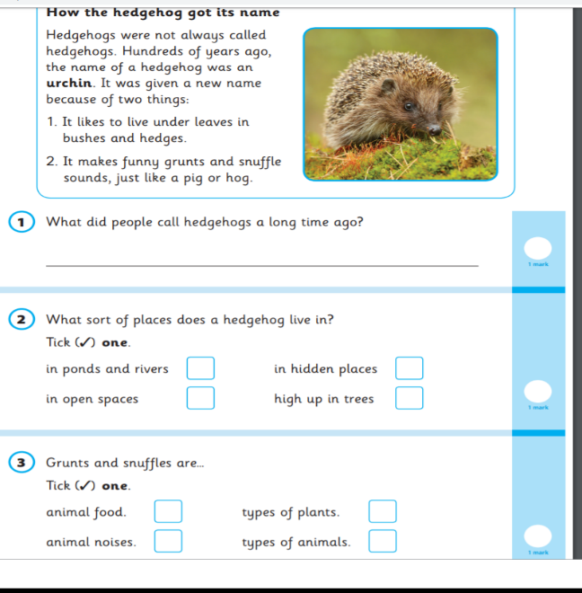
English – Reading Paper 1 Example Page

Slide 5
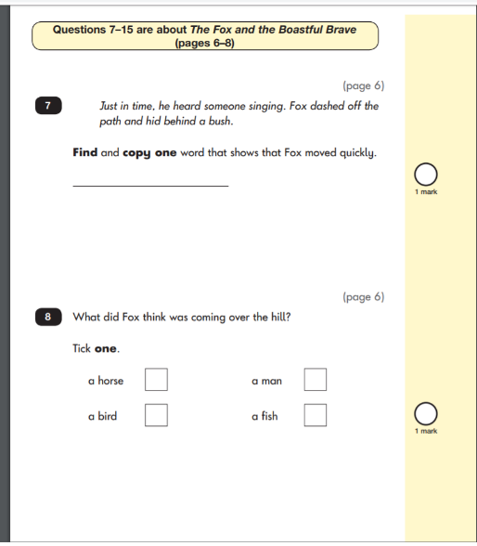
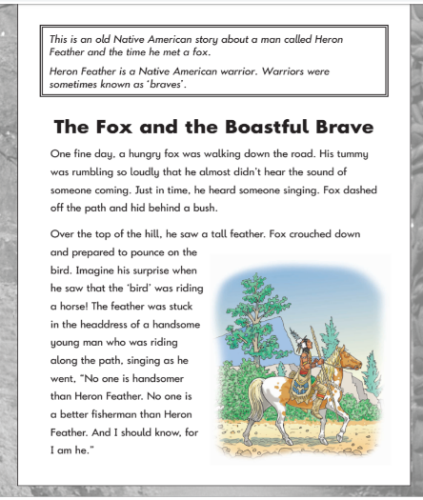
English – Reading Paper 2 Example Pages

Slide 6
English
English
Grammar, Punctuation & Spelling
Paper 1
Spelling test of 20 words
Paper 2
Question Paper to check grammar, punctuation and vocabulary

Slide 7
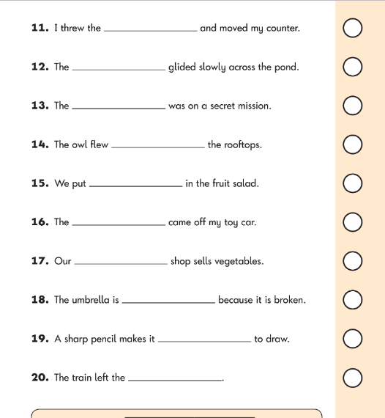
English – Spelling Example Page
English – Grammar Example Page

Slide 8
Maths
Paper 1
Paper 2
Reasoning, problem solving and mathematical fluency
Arithmetic
Arithmetic
& Reasoning
(25 marks available)
(35 marks available)

Slide 9
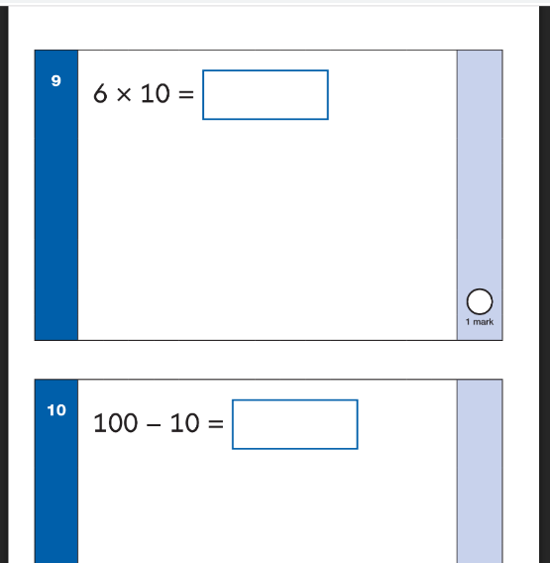
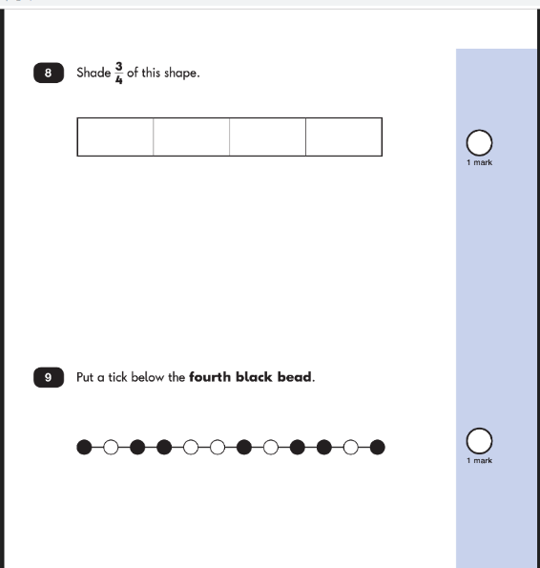
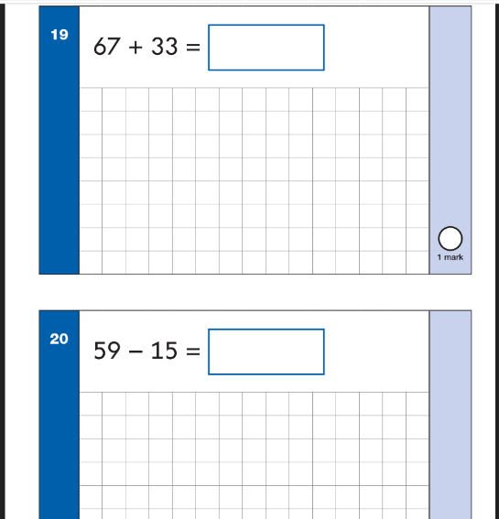
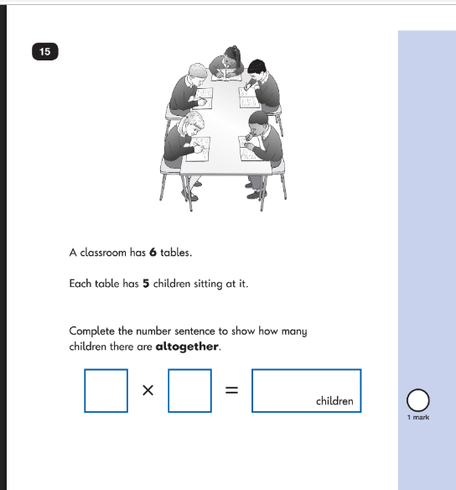
Maths Paper 1 Example Pages (Arithmetic)
Maths Paper 2 Example Pages (Reasoning)

Slide 10
Teacher Assessment/results
KS1 SATs tests are one part of evidence towards the whole teacher assessment.
They are marked in school, and an overall grading based on the whole year’s work
will be made.
The results of the SATs tests are
reported to the Local Authority.
Moderation often takes place to ensure consistency across schools.

Slide 11
Age Related Expectations
Working below the expected standard (not working within the Year 2 Curriculum).
Working towards the expected standard (some of the learning is within the Year 2 Curriculum).
Working at the expected standard (All learning is within the Year 2 Curriculum).
Working at greater depth (very secure in Year 2 Curriculum, with elements of Year 3).

Slide 12
How can you help your child prepare?
Help your child with reading, listen to them read every day and focus on bringing out a ‘love of reading’. Reading stories to your child allows them to develop language, listening skills and comprehension. Encourage making predictions of what might happen next and explaining why things have happened. Encourage children to complete reading comprehension as part of homework
Help your child with writing, support with weekly spellings, practise common exception words. Write together to make shopping lists, letter writing stories etc. Ensure your child is trying hard with their handwriting and spelling regardless of what they’re writing and encourage them to edit when they’re finished.
Help your child with maths, play times table games (2s, 3s, 5s and 10s). Encourage them to help with cooking, weighing and measuring ingredients. Work out what time it is together. Provide opportunities for your child to pay for things in a shop, to work out how much things cost and how much change will be needed.Practise 4 operations - addition, subtraction, multiplication and division with 2 digit numbers.

Slide 13
How can you help your child prepare?
There is no need to panic!
The children have been used to completing assessments throughout the year and these shouldn’t be treated any differently!
Remind them how much progress they have made throughout the year and the tests just prove how well they have done.
Ensure they get enough sleep every night so they can concentrate and achieve the best of their ability.
Tests will be carried out in groups throughout the month of May so children should be well rested and prepared with a good breakfast each day.

Slide 14
Thank You!
Any Questions?

